Slide 1
Artificial Intelligence
CS482, CS682, MW 1 – 2:15, SEM 201, MS 227
Prerequisites: 302, 365
Instructor: Sushil Louis, sushil@cse.unr.edu, http://www.cse.unr.edu/~sushil

Slide 2
Games and game trees
Multi-agent systems + competitive environment → games and adversarial search
In game theory any multiagent environment is a game as long as each agent has “significant” impact on others
In AI many games were
  Game theoretically: Deterministic, Turn taking, Two-player, Zero-sum, Perfect information
  AI: deterministic, fully observable environments in which two agents act alternately and utility values at the end are equal but opposite. One wins the other loses
Chess, Checkers
Not Poker, backgammon,

Slide 3
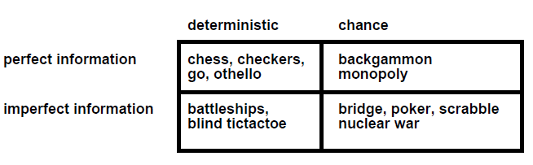
Game types
Starcraft? Counterstrike? Halo? WoW?

Slide 4
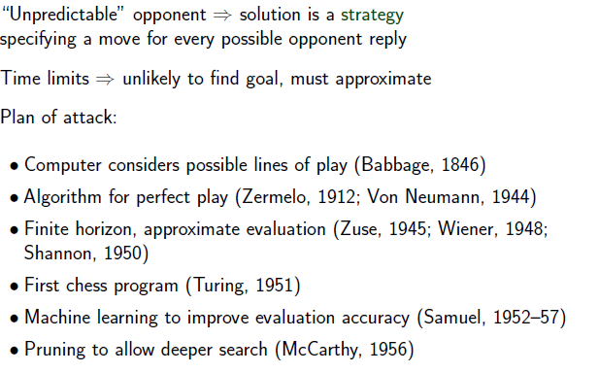
Search in Games

Slide 5
Tic-Tac-Toe
Two player, deterministic, small tree
Two players: Max versus Min
Approximately: 9! tree nodes

Slide 6
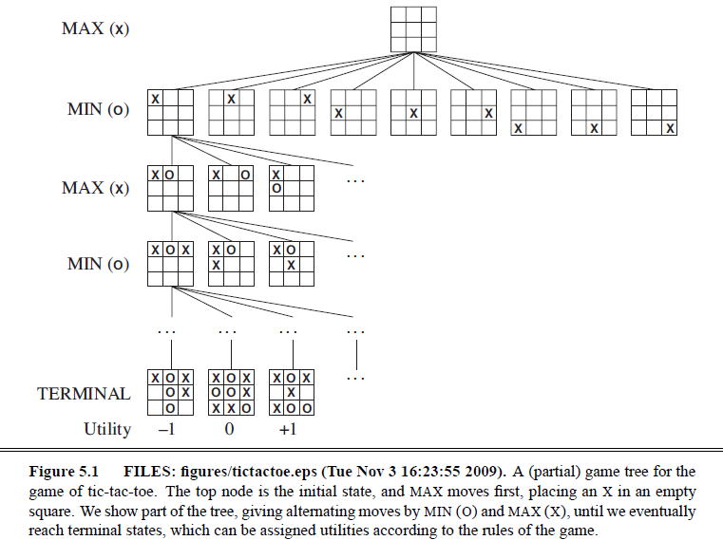
Tic-Tac-Toe

Slide 7
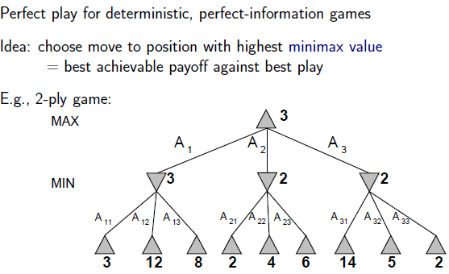
Minimax search

Slide 8
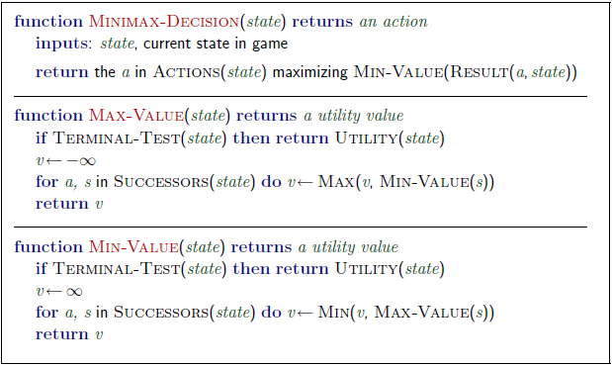
Minimax algorithm

Slide 9
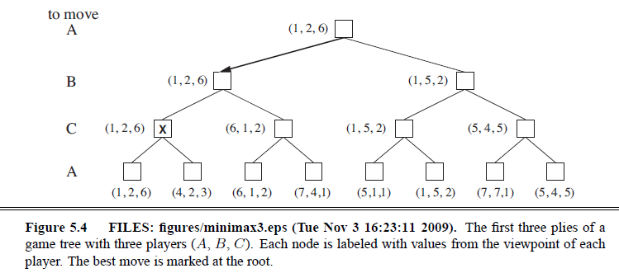
3 player Minimax
Two player minimax reduces to one number because utilities are opposite – knowing one is enough
But there should actually be a vector of two utilities with player choosing to maximize their utility at their turn
So with three players → you have a 3 vector
Alliances?

Slide 10
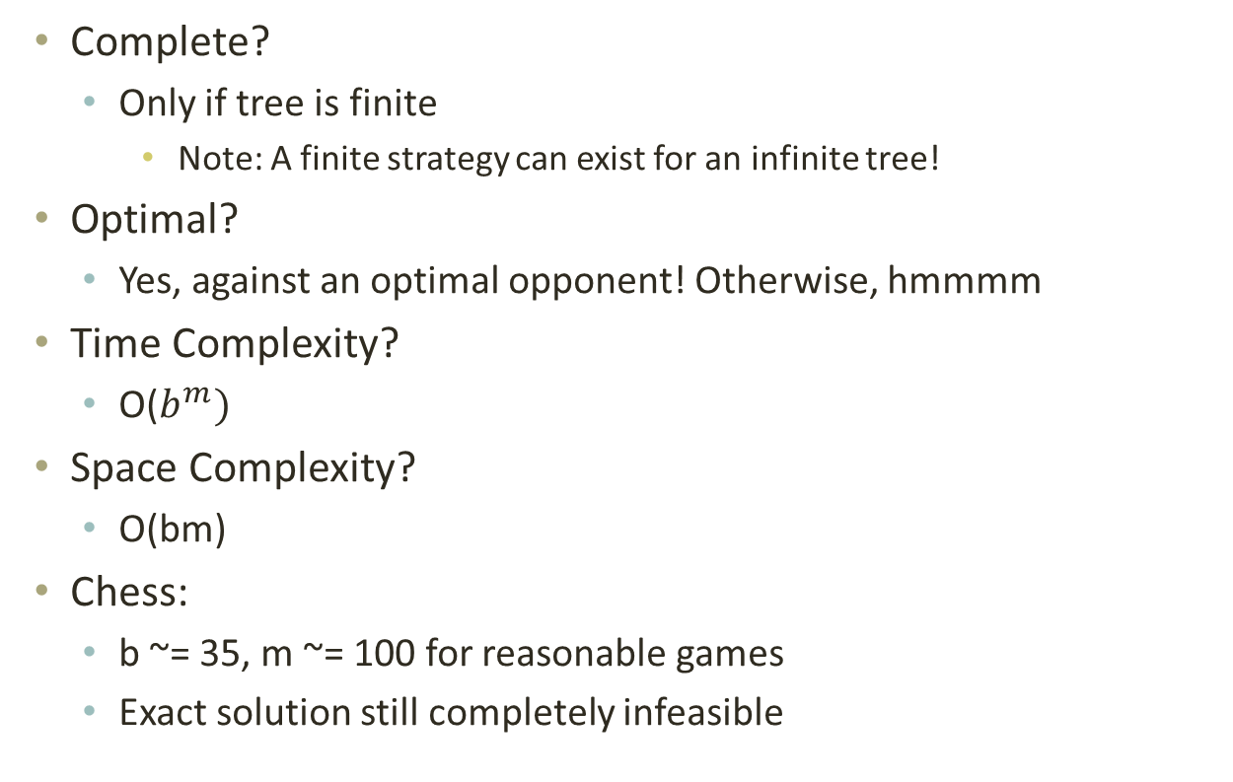
Minimax properties
Complete?
  Only if tree is finite
    Note: A finite strategy can exist for an infinite tree!
Optimal?
  Yes, against an optimal opponent! Otherwise, hmmmm
Time Complexity?
  O($b^{m})$
Space Complexity?
  O(bm)
Chess:
  b ~= 35, m ~= 100 for reasonable games
  Exact solution still completely infeasible

Slide 11
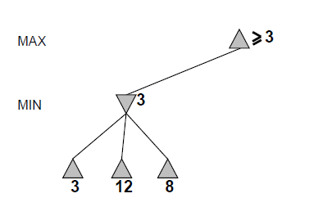
Alpha-beta pruning

Slide 12
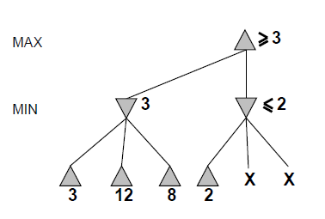
Alpha-beta

Slide 13
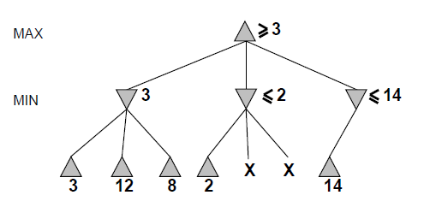
Alpha-beta

Slide 14
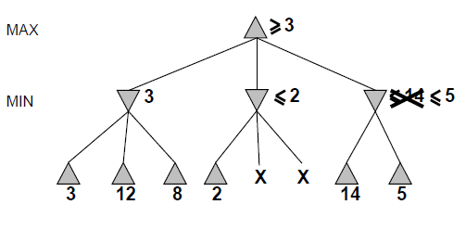
Alpha-beta

Slide 15
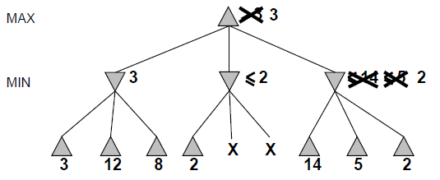
Alpha-beta

Slide 16
Alpha-beta
Alpha is the best value (for Max) found so far at any choice point along the path for Max
  Best means highest
  If utility v is worse than alpha, max will avoid it
Beta is the best value (for Min) found so far at any choice point along the path for Min
  Best means lowest
  If utility v is larger than beta, min will avoid it

Slide 17
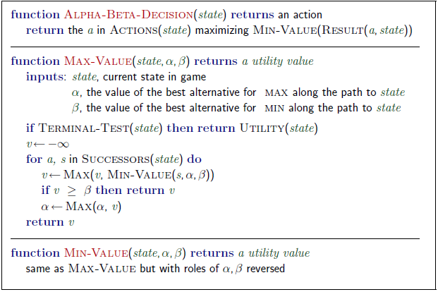
Alpha-beta algorithm

Slide 18
Alpha beta example
Minimax(root)
  = max (min (3, 12, 8), min(2, x, y), min (14, 5, 2))
  = max(3, min(2, x, y), 2)
  = max(3, aValue <= 2, 2)
  = 3

Slide 19
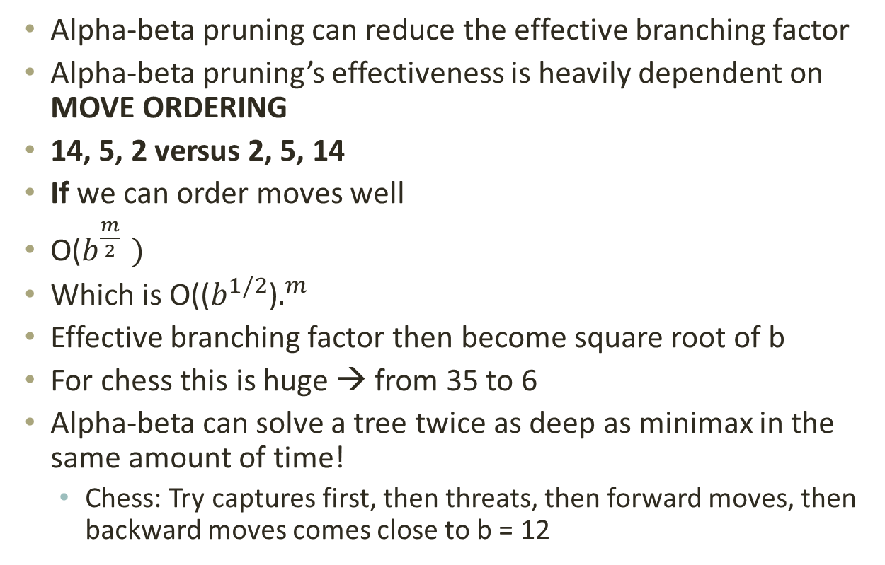
Alpha-beta pruning analysis
Alpha-beta pruning can reduce the effective branching factor
Alpha-beta pruning’s effectiveness is heavily dependent on MOVE ORDERING
14, 5, 2 versus 2, 5, 14
If we can order moves well
O($b^{\frac{m}{2} })$
Which is O(($b^{1/2}$)$.^{m}$
Effective branching factor then become square root of b
For chess this is huge → from 35 to 6
Alpha-beta can solve a tree twice as deep as minimax in the same amount of time!
  Chess: Try captures first, then threats, then forward moves, then backward moves comes close to b = 12

Slide 20
Imperfect information
You still cannot reach all leaves of the chess search tree!
What can we do?
  Go as deep as you can, then
  Utility Value = Evaluate(Current Board)
  Proposed in 1950 by Claude Shannon
Apply an evaluation function to non-terminal nodes
Use a cutoff test to decide when to stop expanding nodes and apply the evaluation function

Slide 21
Evaluation function
Must order nodes in the same way as the utility function
  Wins > Draws > Losses
Fast
  Otherwise it is better to search deeper and get more information
For non-terminal states, high evaluations should mean higher probability of winning
  Chess is not a chancy game
  But computational limitations make eval function chancy!

Slide 22
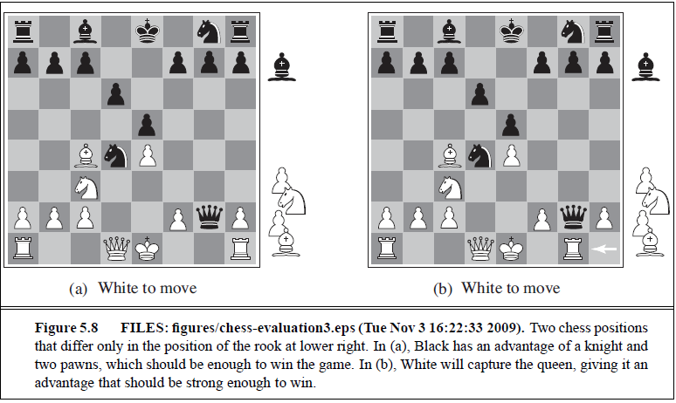
Which is better?

Slide 23
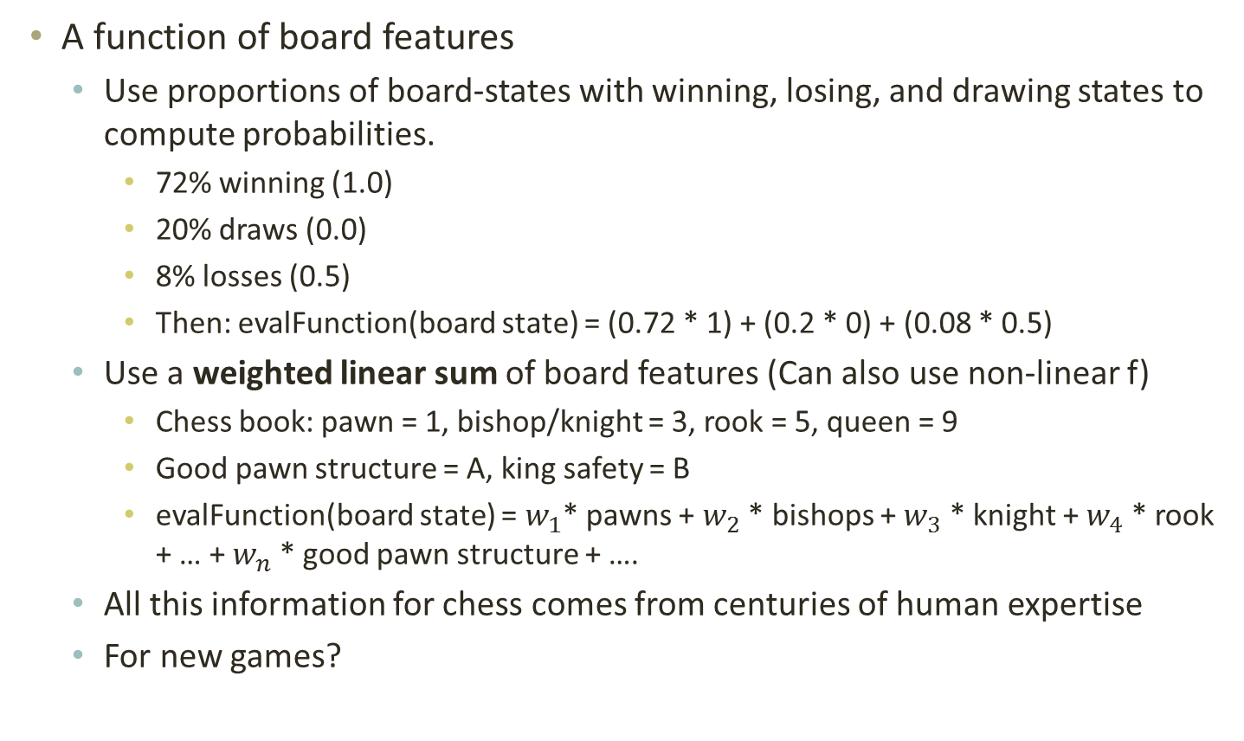
Evaluation functions
A function of board features
  Use proportions of board-states with winning, losing, and drawing states to compute probabilities.
    72% winning (1.0)
    20% draws (0.0)
    8% losses (0.5)
    Then: evalFunction(board state) = (0.72 * 1) + (0.2 * 0) + (0.08 * 0.5)
  Use a weighted linear sum of board features (Can also use non-linear f)
    Chess book: pawn = 1, bishop/knight = 3, rook = 5, queen = 9
    Good pawn structure = A, king safety = B
    evalFunction(board state) = $w_{1}$* pawns + $w_{2}$ * bishops + $w_{3}$ * knight + $w_{4}$ * rook + … + $w_{n}$ * good pawn structure + ….
  All this information for chess comes from centuries of human expertise
  For new games?

Slide 24
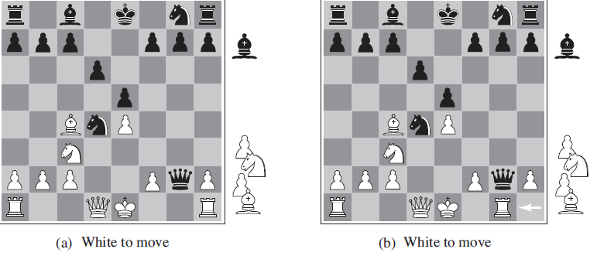
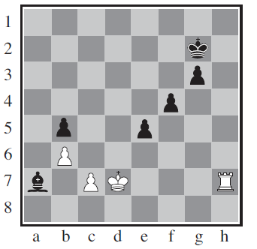
When do we cutoff search
Quiescence
Horizon effect and singular extension

Slide 25
Forward pruning
Beam search
ProbCut – learn from experience to reduce the chance that good moves will be pruned
  Like alpha-beta but prunes nodes that are probably outside the current alpha-beta window
  Othello
Combine all these techniques plus

Slide 26
Table lookups
Chess
  Openings (perhaps upto 10 moves)
  Endings (5, 6 pieces left)
    King-Rook versus King (KRK)
    King-Bishop-Knight versus King (KBNK)
Checkers
  Is solved!

Slide 27
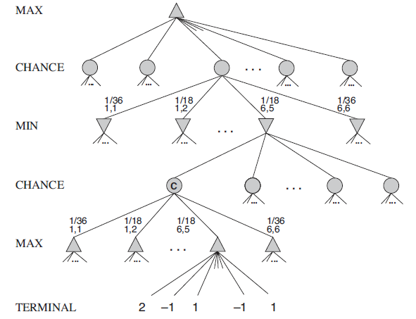
Stochastic Games
Chance is involved (Backgammon, Dominoes, …)
Increases depth if modeled like:

Slide 28
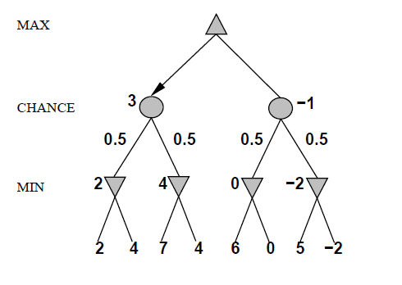
Simple example (coin flipping)

Slide 29
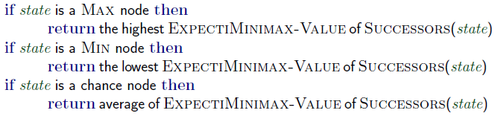
Expected value minimax

Slide 30
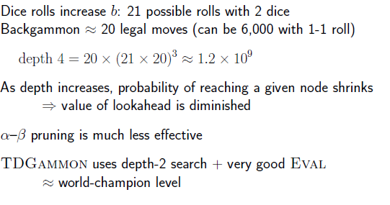
Backgammon

Slide 31
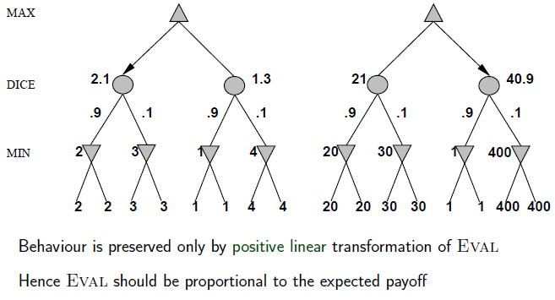
With chance, exact values matter

Slide 32
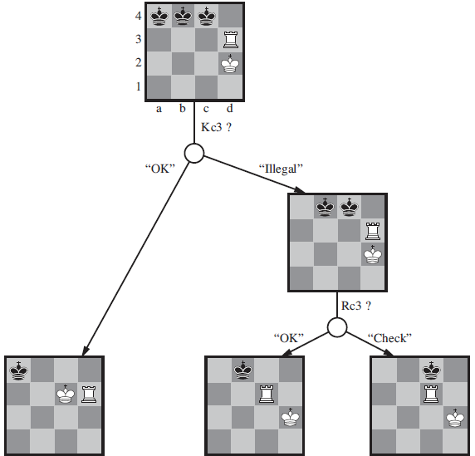
Fog of War
Use belief states to represent the set of states you could be in given all the percepts so far
Kriegspiel
  You can only see your pieces
  Judge says: Ok, illegal, check, …
What is a belief state?

Slide 33
Card Games
Consider all possible deals of a deck of cards, solve each deal as a fully observable game, then choose best move averaged over all deals
Computationally infeasible but:
  Let us do Monte Carlo approximation
  Deal a 100 deals, a 1000 deals, … whatever is computational feasible
  Choose best outcome move
Read section 5.7 – state of the art game programs

Slide 34
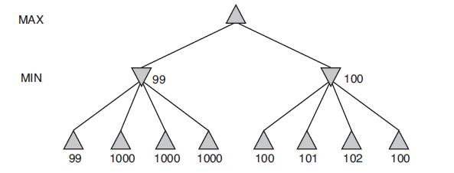
Errors in evaluation functions!

Slide 35
Summary
Games are fun to work on
They give insight on several important issues in AI
  Perfection is unattainable → approximate
  Think about what to think about
  Uncertainty constrains assignment of values to states
  Optimal decisions depend on information state, not real state
Games are to AI as grand prix racing is to automobile design

Slide 36
Searching with Nondeterministic actions
In the past, we knew what state we were in and a solution was a path from root to goal.
Now, how do you find paths when the environment is partially observable or non-deterministic or both and you don’t know what state you are in?
You make contingency plans
  If in state x then y
You use percepts
  I did an action with a non-deterministic result, percepts can tell me which result actually occurred

Slide 37
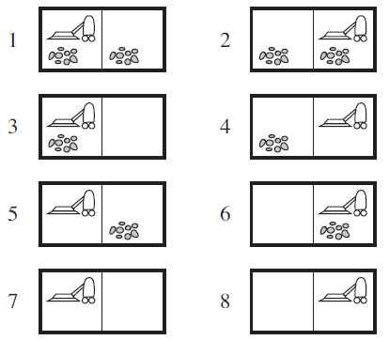
Erratic Vacuum cleaners
Suck
Sometimes cleans adjacent square ☺
Sometimes deposits dirt in current square ☹
Transition Model
  Result → Results
  Suck({1}) → {5, 7}

Slide 38
Erratic Vacuum cleaners
Sometimes cleans adjacent square ☺
Sometimes deposits dirt in current square ☹
Solution
  [Suck, if State == 5 then [Right, Suck] else []]
Solutions are trees! Not sequences
Solutions are nested if-then-else
Many problems in the real world are of this type because exact prediction is impossible
  Keep your eyes open when you drive/walk/fly

Slide 39
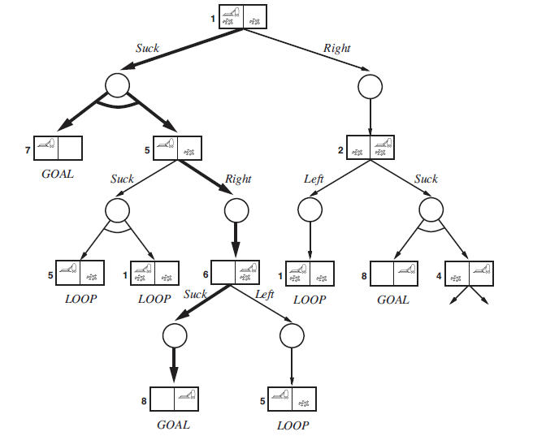
And-Or search trees

Slide 40
And-Or search trees
Or nodes (Suck or Right)
And node {5, 7} → Results
And-Or tree solution is a subtree:
  Goal node at every leaf
  One action at each Or-node
  Includes every outcome branch for And
Same as:
    [Suck, if State == 5 then [Right, Suck] else []]

Slide 41
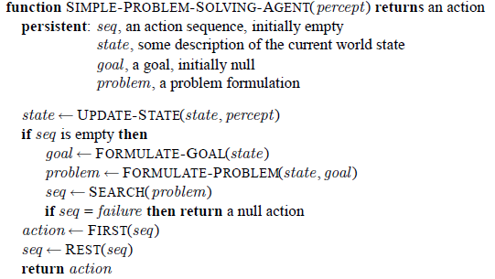
Remember the simple problem solving agent?

Slide 42
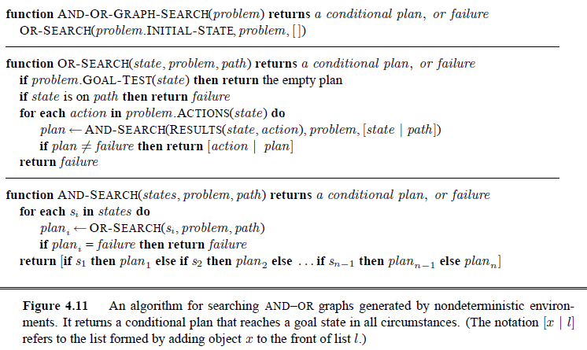
And-Or problem solver
If there is a non-cyclic solution it must be findable from the earlier occurrence of state in path (Completeness)
Recursive, breadth-first. Can use breadth-first, …

Slide 43
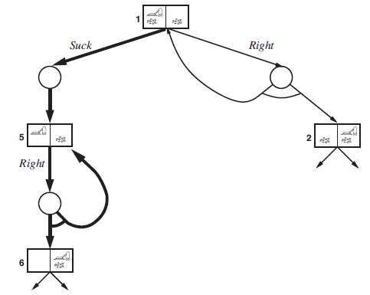
Slippery vacuum worlds
Movement actions sometimes fail and leave you in the same location
No acyclic solutions!
Labels enable cycles
[Suck, L1: Right, if State == 5 then L1 else Suck]

Slide 44
Search
Problem solving by searching for a solution in a space of possible solutions
Uninformed versus Informed search
Local search
Atomic representation of state
Solutions are fixed sequences of actions
With non-deterministic environment solutions are trees – with labels

Slide 45
Quiz (20 minutes)

Slide 46
Types of task environments
Task Env | Observable | Agents | Deterministic | Episodic | Static | Discrete
Soccer
Explore Titan
Shopping for used AI books on the Net
Playing tennis
Playing tennis against a wall
Performing a high jump
Knitting a sweater
Bidding on an item in an auction

