Slide 1
Artificial Intelligence
CS482, CS682, MW 1 – 2:15, SEM 201, MS 227
Prerequisites: 302, 365
Instructor: Sushil Louis, sushil@cse.unr.edu, http://www.cse.unr.edu/~sushil

Slide 2
Search Leftovers
Non-determinism in search
Solutions can be contingency plans (trees)
How do we handle non-determinism?
First: What types of determinism?
Second: For each type, how do we handle it?
Partial Observability
What types of observability do we have?
How do we handle each?
Don’t forget Kriegspeil and partial observability in games
Online-vs-Offline search and execution
Learning search algorithms

Slide 3
Non-determinism in Actions
Erratic vacuum-cleaners
Bad suck actions example
And-Or trees
AND
You can end up in multiple states as the result of an action
You have to find a path from all of these states (AND)
OR
Try each action
Any one action can lead to the goal state(s) (OR)

Slide 4
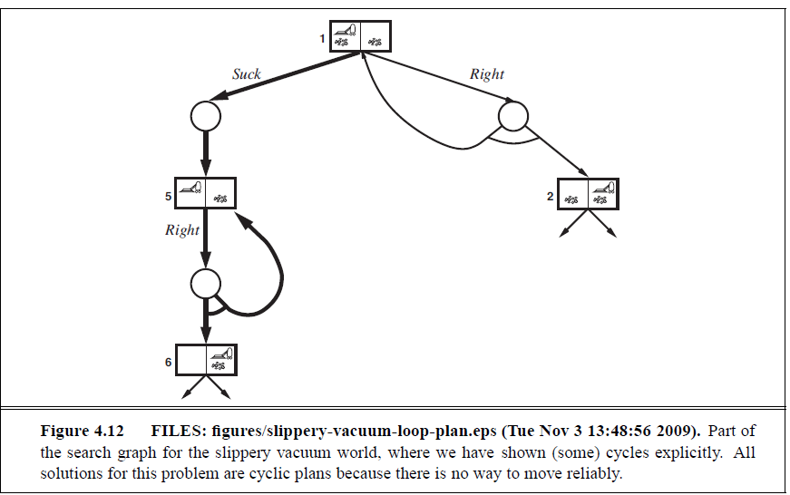
Non-determinism in actions
Slippery vacuum world
If at first you don’t succeed try, try again
We need to add label to some portion of a plan and use the label to refer to that portion – rather than repeating the subplan → And-Or graphs with labels
Plan: [Suck, L1: Right, if State == 5 then L1 else Suck]

Slide 5
Searching with Partial observation
Agents percepts cannot pin down the exact state the agent is in
Let Agents have Belief states
Search for a sequence of belief states that leads to a goal
Search for a plan that leads to a goal
First: NO percepts → sensor-less
States? (Belief states)
Initial State?
Actions?
Transition Model?
Goal test?
Path cost?
Consider sensor-less vacuum world

Slide 6
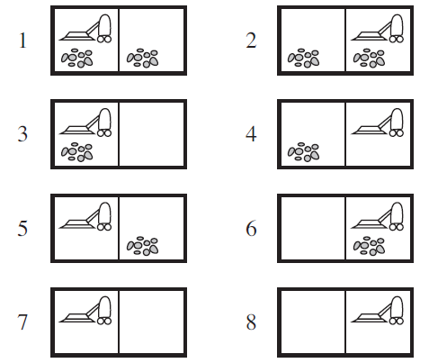
Sensor-less vacuum world
Assume belief states are the same but no location or dust sensors
Initial state = {1, 2, 3, 4, 5, 6, 7, 8}
Action: Right
Result = {2, 4, 6, 8}
Right, Suck
Result = {4, 8}
Right, Suck, Left, Suck
Result = {7} guaranteed!
You do not need sensors to COERCE the world into a specific state!

Slide 7
Sensor-less search
Search in belief state space, where the problem is fully observable!
Solution is a sequence, even if the environment is non-deterministic!
Suppose the underlying problem (P) is
{${Actions}_{p},{Result}_{p}, {Goal−Test}_{p}, {Step−Cost}_{p}$}
What is the corresponding sensor-less problem
States → Belief States: every possible set of physical states
If N physical states, number of belief states can be $2^{N}$
Initial State: Typically the set of all states in P
Actions: Consider {s1, s2}
If ${Actions}_{p}$(s1) != ${Actions}_{p}$(s2) should we take the Union of both sets of actions or the Intersection?
Union if all actions are legal, intersection if not

Slide 8
Sensor-less search (cont’d)
Transition model
Union of all states that ${Result}_{p}$(s) returns for all states, s, in your current belief state
$b^{′}=Result\left(b, a\right)$ = {$s^{′}$ : $s^{′}$ = ${Result}_{p}$(s, a) and s ϵ b}
This is the prediction step, ${Predict}_{p}$(b, a)
Goal-Test: If all physical states in belief state satisfy ${Goal−Test}_{p}$
Path cost → Tricky in general. Consider what happens if actions in different physical states have different costs. For now assume cost of an action is the same in all states

Slide 9
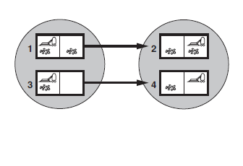
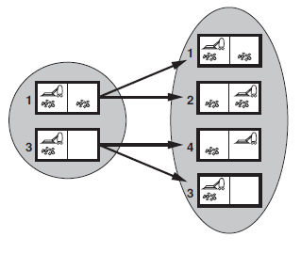
Examples
Erratic - Right
Slippery – Right
Action can increase the number of physical states in a belief state

Slide 10
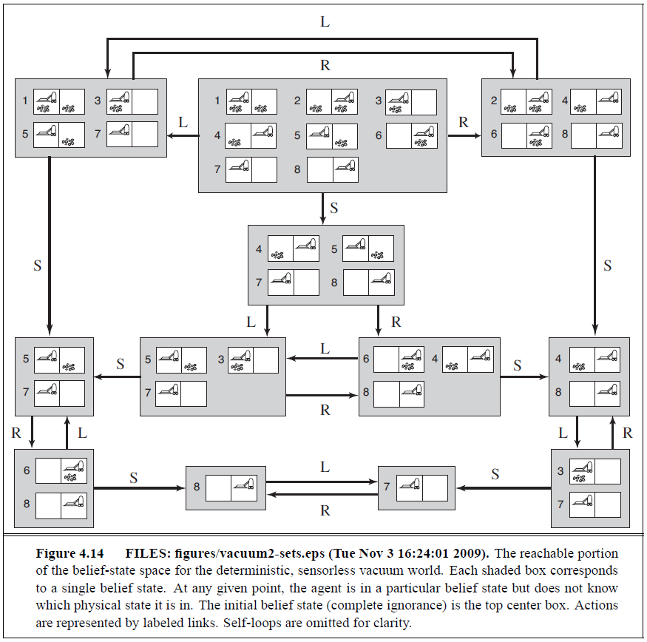

Slide 11
Belief states synposis
Search through belief state space is usually worse than physical state space (size)
Alternatives:
Logic representations
Incremental belief-state search
For each physical state in belief state find a solution that will take you to goal
Fast failure but have to find one solution that works for all physical states in initial state

Slide 12
Searching with observations
Many problems require sensors
Percept(s) or Percepts(s) function
Vacuum world example
Location sensor
Current location dirt sensor. Cannot detect dirt in other square
Percept(s1) = [A, Dirty]
Observability
Sensor-less problems → Percepts(s) = Null for all s
Fully observable → Percepts(s) = s for every s

Slide 13
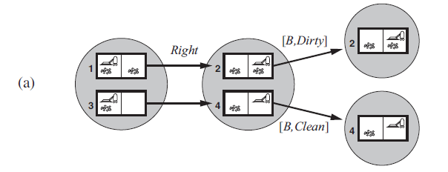
Example
If you get [A, Dirty] you could be in {1, 3}
Result({1, 3}, Right) is
Now
if you see (observe) [B, Dirty] you are in {2}
If you observe [b, Clean] you are in {4}
Transition Model is more complicated, otherwise this is not very different from other search problems

Slide 14
3-stage transition model
Prediction stage
Predicted belief state is b^ = Predict(b, a)
Observation prediction stage
Possible-Percepts(b^) = {o : o = Percept(s) and s ϵ b^}
Update stage
$b_{o}$ = Update(b^, o) = {s : o = Percept(s) and s ϵ b^}
So, Results(b, a)
= {$b_{o}$ : $b_{o}$ = Update(Predict(b, a), o) and o ϵ Possible-Percepts(Predict(b, a))}

Slide 15
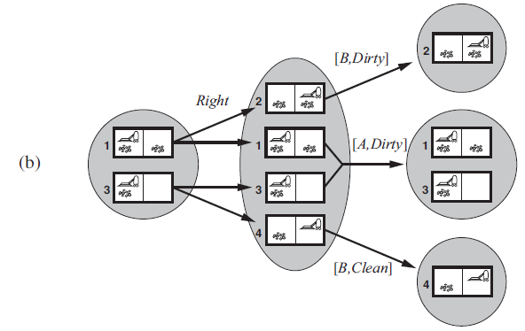
Example: Slippery vacuum

Slide 16
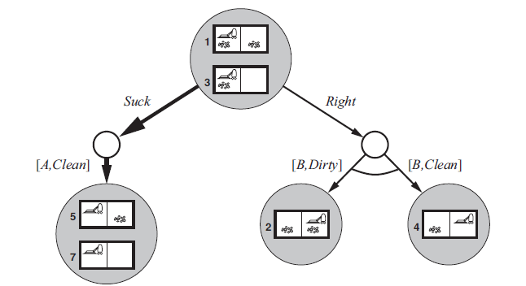
And-Or solution
Given this problem formulation, we can use the And-Or search algorithm to come up with a plan to solve the problem
Given [A, Dirty], Plan = {Suck, Right, if Bstate = {6} then Suck else []}

Slide 17
Partially observable environments
An agent in a partially observable environment must update belief state from percept
b’ = Update(Predict(b, a), o)
So the agent is only looking at the current o (percept) not the entire history, as we considered earlier. This is recursive state estimation
Example: Kindergarten vacuum world

Slide 18
Localization in robotics
Maintaining belief states is a core function of any Intelligent Agent
Monitoring, filtering, state estimation
Robot:
Four sonar sensors (NSWE) → give correct data
Robot has correct map of environment
Move is broken → Robot moves to random adjacent square
Robot must determine current location
Suppose it gets [NSW] → obstacles N, S, and W

Slide 19
Robot localization
It must be in one of the following squares after [NSW]
Now it gets [NS], where can it be?

Slide 20
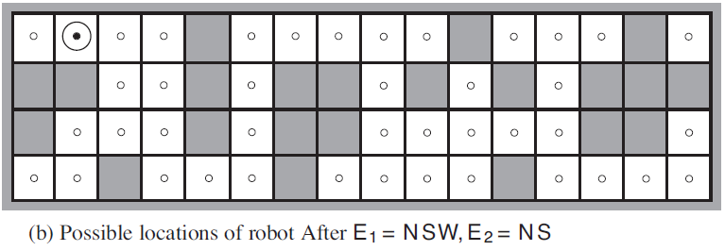
Robot localization
Only one location possible
Percepts usually reduce uncertainity

Slide 21
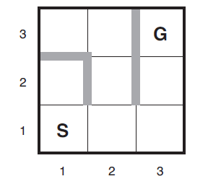
Online search
Not find plan then execute then stop
Compute, execute, observe, compute, execute, …
Interleave computation and action
Great for
dynamic domains
Non deterministic domains
Necessary in unknown environments
Robot localization in an unknown environment (no map)
Does not know about obstacles, where the goal is, that UP from (1,1) goes to (1, 2)
Once in (1, 2) does not know that down will go to (1, 1)
Some knowledge might be available
If location of goal is known, might use Manhattan distance heuristic
Competitive Ratio = Cost of shortest path without exploration/Cost of actual agent path
Irreversible actions can lead to dead ends and CR can become infinite

Slide 22
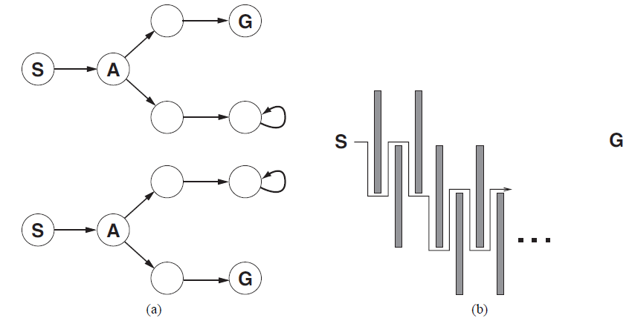
Examples
Adversary argument

Slide 23
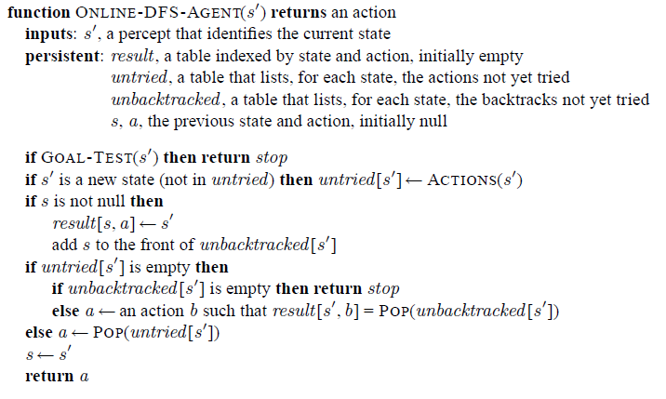
Online search algorithms
Local search is better!
Online-DFS

Slide 24
Online local search
Hill-climbing is already an online search algorithm but stops at local optimum. How about randomization?
Cannot do random restart (you can’t teleport a robot)
How about just a random walk instead of hill-climbing?
Can be very bad (two ways back for every way forward above)
Let’s augment HC with memory
Learning real-time A* (LRTA*)
Updates cost estimates, g(s), for the state it leaves
Likes unexplored states
f(s) = h(s) not g(s) + h(s) for unexplored states

Slide 25
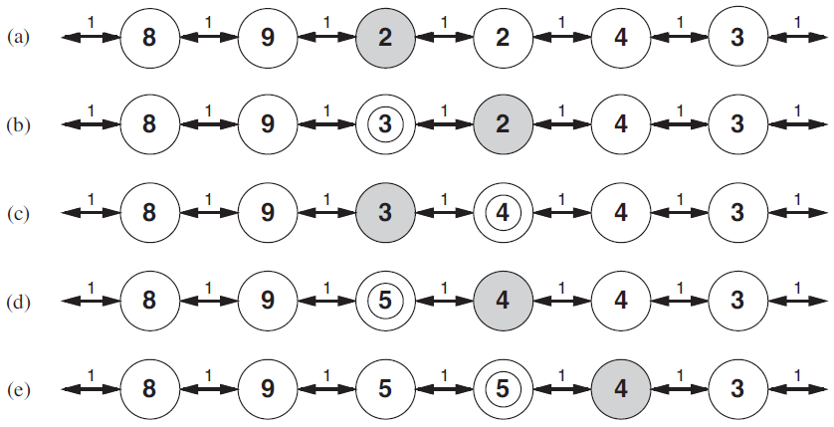
LRTA* Example
We are in shaded state

Slide 26
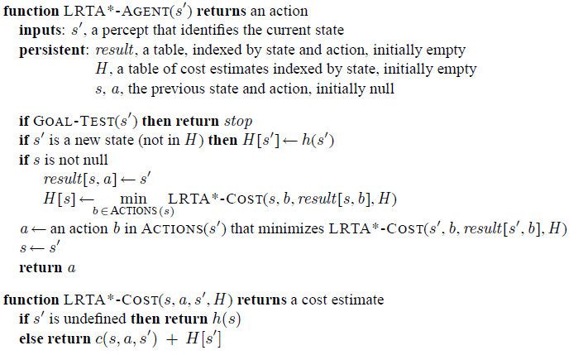
LRTA* algorithm

Slide 27
Questions
DFS always expands at least as many nodes as A* with an admissable heuristic (True/False). Explain.
H(n) = 0 is an admissible heuristic for the 8-puzzle
BFS is complete even if 0 step costs are allowed

Slide 28
Types of task environments
Task Env | Observable | Agents | Deterministic | Episodic | Static | Discrete
Soccer
Explore Titan
Shopping for used AI books on the Net
Playing tennis
Playing tennis against a wall
Performing a high jump
Knitting a sweater
Bidding on an item in an auction

