Slide 1
Artificial Intelligence
CS482, CS682, MW 1 – 2:15, SEM 201, MS 227
Prerequisites: 302, 365
Instructor: Sushil Louis, sushil@cse.unr.edu, http://www.cse.unr.edu/~sushil

Slide 2
Constraint satisfaction problems
Constraints on the values of variables that define system state
What’s new
State is no longer a black box
Previously all you could do with states was
Test if two states were the same
Tell if a state was a goal state
Now: State space is defined by the values of a set of variables
Each variable’s set of values is the variable’s domain
There can be
Unary
Binary
Path
Constraints

Slide 3
CSP
Find values of variables that satisfy all problem constraints
How?
Search, of course
Can we use any search method?
Hmm, some intuition from considering specific problems will help

Slide 4
Three colour problem
Neighboring regions cannot have the same color
Colors = {red, blue, green}

Slide 5
Consider using a local search
WA | NT | NSW | Queen | Victoria | SA | Tas
{r, g, b} | {r, g, b} | {r, g, b} | {r, g, b} | {r, g, b} | {r, g, b} | {r, g, b}
- 3 to the power 7 possible states = 2187
But not all states are legal
For example: {r, r, r, r, r, r, r} is NOT legal because it violates our constraint
Suppose we do sequential assignment of values to variables
Assign r (say) to WA then we can immediately reduce the number of possible values for NT and SA to be {g, b}, and if we chose NT = {g}, then SA has to be {b}.

Slide 6
Propagation of constraints
g
r
g
r
?, ?, ?
b
b
?, ?, ?
?, ?, ?
?, ?, ?

Slide 7
Types
Discrete finite domains
Map coloring, scheduling with time limits
Can enumerate all legal value combinations (that specify constraints)
Discrete infinite domains
Ex: Variable values can be the set of integers
Needs a constraint language to specify constraints
We have solutions for linear constraints over integers
We can prove that no algorithm exists for solving general nonlinear constraints over integers
Continuous domains
Hubble telescope scheduling is continuous over time and must obey a variety of astronomical, precedence, and power constraints
Linear programming → poly time algorithms

Slide 8
Types
Unary constraints
Truck height < 14 feet
Binary constraints
WA != SA

Slide 9
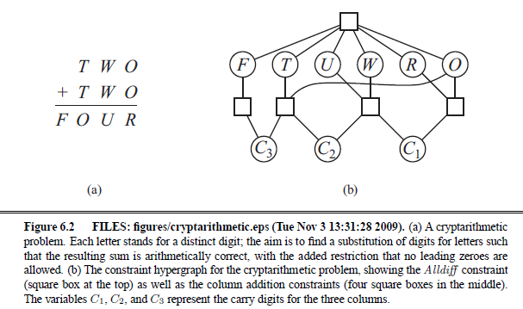
Cryptarithmetic puzzles

Slide 10
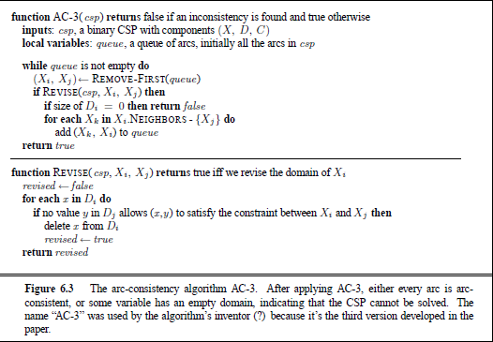
Wouldn’t it be nice to have a constraint propagation algorithm?

Slide 11
Properties
Node consistency (unary)
Arc consistency (binary)
Network arc consistency (all arcs are consistent)
ACS3 is the most popular arc consistency algorithm
Fails quickly if no consistent set of values found
Start:
Considers all pairs of arcs
If making an arc (xi, xj) consistent causes domain reduction
Add all neighboring arcs that go to xi to set of arcs to be considered
Success leaves a much smaller search space for search
Domains will have been reduced
Suppose n variables, max domain size is d, then complexity is O(cd^3) where c is number of binary constraints

Slide 12
More constraint types and approaches
Path (triples)
Global constraints (n variables)
Special purpose algorithms (heuristics)
Alldiff constraints (Sudoku)
Remove any variable with singleton domain
Remove that value from the domains of all other variables
Repeat
While
singletons values remain
No domains are empty
Not more variables than domain values
Resource constraints (Ex: Atmost 100)
Bounds and bounds propagation

Slide 13
Search
Constraints have been met and propagated
But the problem still remains to be solved (multiple values in domains)
Search through remaining assignments
For CSPs Backtracking search is good
Choose a value for variable, x
Choose a subsequent legal value for next variable, y
Backtrack to x if no legal value found for y

Slide 14
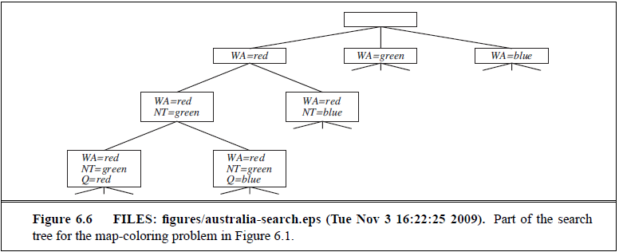
Australia coloring

Slide 15
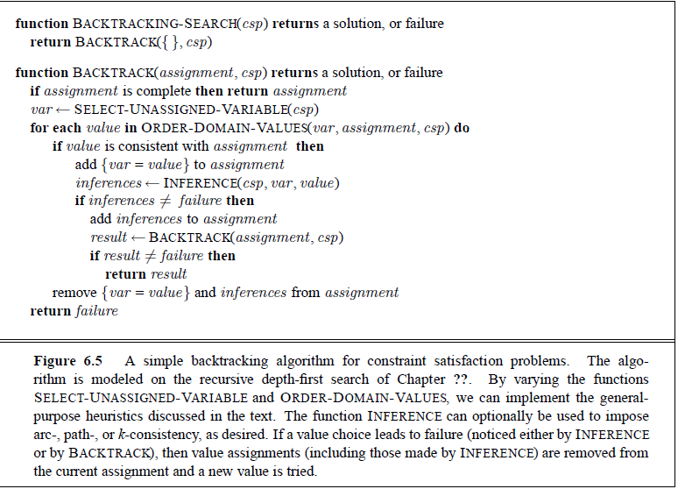
Backtracking search algorithm

Slide 16
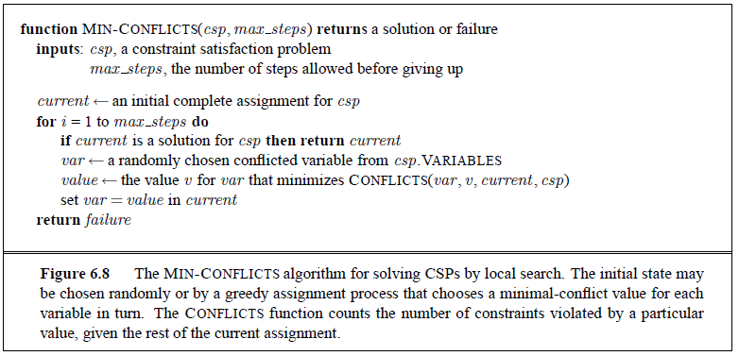
Local search for CSPs

Slide 17
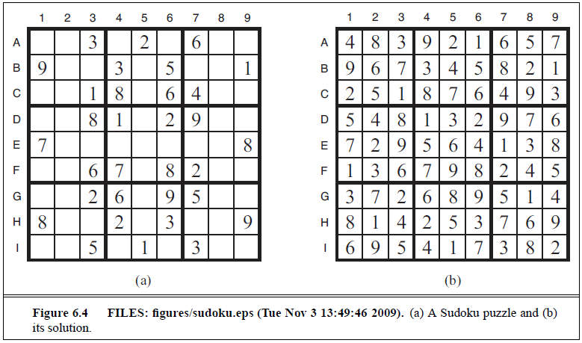
SudoKu

