Slide 1
Evolutionary Computation
Instructor: Sushil Louis, sushil@cse.unr.edu, http://www.cse.unr.edu/~sushil

Slide 2
Genetic Algorithm
Generate pop(0)
Evaluate pop(0)
T=0
While (T < maxGen) do
Select pop(T+1) from pop(T)
Recombine pop(T+1)
Evaluate pop(T+1)
T = T + 1
Done

Slide 3
How does it work
String decoded f(x^2) fi/Sum(fi) Expected Actual
01101 | 13 | 169 | 0.14 | 0.58 | 1
11000 | 24 | 576 | 0.49 | 1.97 | 2
01000 | 8 | 64 | 0.06 | 0.22 | 0
10011 | 19 | 361 | 0.31 | 1.23 | 1
Sum |  | 1170 | 1.0 | 4.00 | 4.00
Avg |  | 293 | .25 | 1.00 | 1.00
Max |  | 576 | .49 | 1.97 | 2.00

Slide 4
How does it work cont’d
String mate offspring decoded f(x^2)
0110|1 | 2 | 01100 | 12 | 144
1100|0 | 1 | 11001 | 25 | 625
11|000 | 4 | 11011 | 27 | 729
10|011 | 3 | 10000 | 16 | 256
Sum |  |  |  | 1754
Avg |  |  |  | 439
Max |  |  |  | 729

Slide 5
GA code
Here is some new GA code
Otherwise, there is code on the internet in multiple languages and the
ECSL Lab has developed well understood, local code

Slide 6
Randomized versus Random versus Deterministic search algorithms
We want fast, reliable, near-optimal solutions from our algorithms
Reliability
Speed
Performance
Deterministic
Search once
Random
Average over multiple runs
Randomized hill climber, GA, SA, …
Average over multiple runs
We need reproducible results so understand the role of the random seed in a random number generator

Slide 7
Representations
Why binary?
Later
Multiple parameters (x, y, z…)
Encode x, encode y, encode z, … concatenate encodings to build chromosome
As an example consider the DeJong Functions
And now for something completely different: Floorplanning
TSP
Later
JSSP/OSSP/…
Later

Slide 8
Representations
[-x..y] ?
Min, max, precision and number of bits

Slide 9
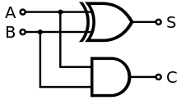
Representations/Apps
Design an adder logic circuit
Invert a non-linear model
Design a truss for the space station
Find the shortest route for a traveling salesperson
Forward model
Given F
F = ma = m dv/dt = …
Computes Δposition
Compute F
F = ma = m dv/dt = …
Given Δposition
Inverse model

Slide 10
Designing a parity checker
Parity: if even number of 1s in input correct output is 0, else output is 1
Important for computer memory and data communication chips
Search for circuit that performs parity checking
What is the genotype? – selected, crossed over and mutated
A circuit is the phenotype – evaluated for fitness.
How do you construct a phenotype from a genotype to evaluate?

Slide 11
What is a genotype?
A genotype is a bit string that codes for a phenotype
1
1
0
1
0
0
1
0
0
1
1
1
Randomly chosen crossover point
1
1
1
1
1
1
1
1
0
0
0
0
Parents
Crossover
Offspring
0
0
0
0
0
0
0
0
1
1
1
1
Mutation
1
1
1
1
1
1
Randomly chosen mutation point
1
1
1
1
0
1

Slide 12
Genotype to Phenotype mapping
A circuit is made of logic gates. Receives input from the 1st column and we check output at last column.
1
6
11
16
21
26
31
Each group of five bits codes for one of 16 possible gates and the location of second input
146

Slide 13
Genotype to Phenotype mapping
150 length binary string
1
1
0
1
0
0
1
0
0
1
1
1
1
0
1
1
1
0
1
1 row of 150
becomes
6 rows of 25
0
1
0
1
0
0
1
1
0
0
0
0
0
0
1
0
1
1
0
0
1
1
1
0
1
1
0
0
0
1
0
0
0
0
1

Slide 14
Evaluating the phenotype
Feed the gate an input combination
Check whether the output produced by a decoded member of the population is correct
Give one point for each correct output
That is: Simulate the circuit
The black box can be a simulation
Evaluate/
Circuit simulation
Chromosome
Fitness

Slide 15
Simulation
double Eval(int *chrom){
int nInputs = (int) pow((double) 2.0, (double) nBits);
FindAnswerVec(nBits, nInputs);//sets answerVec
double sum = 0;
for(int n = 0; n < nInputs; n++){
FixInput(n, pj);
for(int i = 0; i < maxCols; i++){
for(int j = 0; j < maxRows; j++){
int index = ToIndex(j, i);
outVec[j][i+1] = Simulate(pj, pj->chrom, index, i, j, n);
}
}
sum += Match(outVec, 0, maxCols, n);//Match with answerVec
}
return sum;
}

Slide 16
Circuits
Parity Checker
Adder

Slide 17
Predicting subsurface structure
Find subsurface structure that agrees with experimental observations
Mining, oil exploration, swimming pools

Slide 18
Designing a truss
Find a truss configuration that minimizes vibration, minimizes weight, and maximizes stiffness

Slide 19
Traveling Salesperson Problem
Find a shortest length tour of N cities
N! possible tours
10! = 3628800
70! = 11978571669969891796072783721689098736458938142546425857555362864628009582789845319680000000000000000
Chip layout, truck routing, logistics

Slide 20
Consider combinational logic
A | B | Output
0 | 0 | 0
0 | 1 | 1
1 | 0 | 1
1 | 1 | 0
A | B | Output
0 | 0 | 0
0 | 1 | 1
1 | 0 | 1
1 | 1 | 1
A | B | Output
0 | 0 | 0
0 | 1 | 0
1 | 0 | 0
1 | 1 | 1

Slide 21
Consider combinational logic
A | B | Output
0 | 0 | 0
0 | 1 | 1
1 | 0 | 1
1 | 1 | 0
XOR
A | B | Output
0 | 0 | 0
0 | 1 | 1
1 | 0 | 1
1 | 1 | 1
OR
A | B | Output
0 | 0 | 0
0 | 1 | 0
1 | 0 | 0
1 | 1 | 1
AND

Slide 22
Consider combinational logic
A | B | Output
0 | 0 | 0
0 | 1 | 0
1 | 0 | 0
1 | 1 | 0
A | B | Output
0 | 0 | 0
0 | 1 | 0
1 | 0 | 0
1 | 1 | 1
AND
A | B | Output
0 | 0 | 0
0 | 1 | 0
1 | 0 | 1
1 | 1 | 0

Slide 23
Consider combinational logic
A | B | Output
0 | 0 | 0
0 | 1 | 0
1 | 0 | 1
1 | 1 | 1
A | B | Output
0 | 0 | 0
0 | 1 | 1
1 | 0 | 0
1 | 1 | 0
AND
A | B | Output
0 | 0 | 0
0 | 1 | 1
1 | 0 | 0
1 | 1 | 1

Slide 24
GA Theory
Why fitness proportional selection?
Fitness proportional selection optimizes the tradeoff between exploration and exploitation. Minimizes the expected loss from choosing unwisely among competing schema
Why binary representations?
Binary representations maximize the ratio of the number of schemas to number of strings
Excuse me, but what is a schema?
Mutation can be thought of as beam hill-climbing. Why have crossover?
Crossover allows information exchange that can lead to better performance in some spaces

Slide 25
Schemas and Schema Theorem
How do we analyze GAs?
Individuals do not survive
Bits and pieces of individuals survive
Three questions:
What do these bits and pieces signify?
How do we describe bits and pieces?
What happens to these bits and pieces over time?

Slide 26
Schemas
What does part of a string that encodes a candidate solution signify?
1
1
1
0
0
0
A point in the search space
1
1
1
An area of the search space
Different kinds of crossover lead to different kinds of areas that need to be described
1
0
1
A different kind of area
1
*
*
0
1
*
A schema denotes a portion of the search space

Slide 27
Schema notation
Schema H = 01*0* denotes the set of strings:
01000
01001
01100
01101

Slide 28
Schema properties
Order of a schema H →O(H)
Number of fixed positions
O(10**0) = 3
Defining length of a schema
Distance between first and last fixed position
d(10**0) = 4
d(*1*00) = 3

Slide 29
What does GA do to schemas?
What does selection do to schemas?
If m (h, t) is the number of schemas h at time t then
m(h, t+1) = $\frac{f_{i}}{\overline{f}}$ m (h, t) → above average schemas increase exponentionally!
What does crossover do to schemas?
Probability that schema gets disrupted
Probability of disruption = $P_{c} \frac{∂(h)}{l−1}$
This is a conservative probability of disruption. Consider what happens when you crossover identical strings
What does mutation do to schemas?
Probability that mutation does not destroy a schema
Probability of conservation = ${(1 − P_{m})}^{o(h)}$ = (1 - $o(h)$ $P_{m}$ - (higher order terms))

Slide 30
The Schema theorem
Schema Theorem:
M(h, t+1) $≥$ $\frac{f_{i}}{\overline{f}}$ m (h, t) $\left[1 −P_{c} \frac{∂\left(h\right)}{l−1} −o(h) P_{m}\right]$ … ignoring higher order terms
The schema theorem leads to the building block hypothesis that says:
GAs work by juxtaposing, short (in defining length), low-order, above average fitness schema or building blocks into more complete solutions

Slide 31
Schema processing
String decoded f(x^2) fi/Sum(fi) Expected Actual
01101 | 13 | 169 | 0.14 | 0.58 | 1
11000 | 24 | 576 | 0.49 | 1.97 | 2
01000 | 8 | 64 | 0.06 | 0.22 | 0
10011 | 19 | 361 | 0.31 | 1.23 | 1
Sum |  | 1170 | 1.0 | 4.00 | 4.00
Avg |  | 293 | .25 | 1.00 | 1.00
Max |  | 576 | .49 | 1.97 | 2.00
 |  | Fitness
1**** | 2,4 | 469 |  | 3.2 | 3
*10** | 2,3 | 320 |  | 2.18 | 2
1***0 | 2 | 576 |  | 1.97 | 2

Slide 32
Schema processing…
String mate offspring decoded f(x^2)
0110|1 | 2 | 01100 | 12 | 144
1100|0 | 1 | 11001 | 25 | 625
11|000 | 4 | 11011 | 27 | 729
10|011 | 3 | 10000 | 16 | 256
Sum |  |  |  | 1754
Avg |  |  |  | 439
Max |  |  |  | 729
 | Exp count | Actual | Represented by | Exp after all ops | Actual after all ops
1**** | 3.2 | 3 | 2,3,4 | 3.2 | 3 | 2,3,4
*10** | 2.18 | 2 | 2,3 | 1.64 | 2 | 2,3
1***0 | 1.97 | 2 | 2,3 | 0.0 | 1 | 4

Slide 33
Questions
Parameter values:
Populations size? As large as possible (for x^2 start with 50)
Number of generations? Depends on selection strategy and problem (for x^2 pop of 50 try 100)
Debug hint: Try popsize of 2 run for 1 generation
Crossover probability (pcross):
Depends on selection strategy and problem (try 0.667)
What do you expect the GA “does” when pcross and pmut are 0?
Mutation probability (pmut):
Depends on selection strategy and problem (try 0.001)
What do you expect to see when pmut is high (0.2) or low (0.0)?
Problem: What do you expect on fitness function:
F(x) = 100, F(x) = number of ones. F(x) = x^2, F(x) = 2^x, F(x) = x!

Slide 34
Representations
[-x..y] ?
Min, max, precision and number of bits

Slide 35
For each parameter in chrom
Min + decode(chrom[start], size) * precision
Precision = (max – min) / 2^n
n = Ceiling(logbase2(max – min))

Slide 36
GA Theory
Why fitness proportional selection?
Fitness proportional selection optimizes the tradeoff between exploration and exploitation. Minimizes the expected loss from choosing unwisely among competing schema
Why binary representations?
Binary representations maximize the ratio of the number of schemas to number of strings
Excuse me, but what is a schema?
Mutation can be thought of as beam hill-climbing. Why have crossover?
Crossover allows information exchange that can lead to better performance in some spaces

Slide 37
Schemas and Schema Theorem
How do we analyze GAs?
Individuals do not survive
Bits and pieces of individuals survive
Three questions:
What do these bits and pieces signify?
How do we describe bits and pieces?
What happens to these bits and pieces over time?

Slide 38
Schemas
What does part of a string that encodes a candidate solution signify?
1
1
1
0
0
0
A point in the search space
1
1
1
An area of the search space
Different kinds of crossover lead to different kinds of areas that need to be described
1
0
1
A different kind of area
1
*
*
0
1
*
A schema denotes a portion of the search space

Slide 39
Schema notation
Schema H = 01*0* denotes the set of strings:
01000
01001
01100
01101

Slide 40
Schema properties
Order of a schema H →O(H)
Number of fixed positions
O(10**0) = 3
Defining length of a schema
Distance between first and last fixed position
d(10**0) = 4
d(*1*00) = 3

Slide 41
What does GA do to schemas?
What does selection do to schemas?
If m (h, t) is the number of schemas h at time t then
m(h, t+1) = $\frac{f_{i}}{\overline{f}}$ m (h, t) → above average schemas increase exponentionally!
What does crossover do to schemas?
Probability that schema gets disrupted
Probability of disruption = $P_{c} \frac{∂(h)}{l−1}$
This is a conservative probability of disruption. Consider what happens when you crossover identical strings
What does mutation do to schemas?
Probability that mutation does not destroy a schema
Probability of conservation = ${(1 − P_{m})}^{o(h)}$ = (1 - $o(h)$ $P_{m}$ - (higher order terms))

Slide 42
The Schema theorem
Schema Theorem:
M(h, t+1) $≥$ $\frac{f_{i}}{\overline{f}}$ m (h, t) $\left[1 −P_{c} \frac{∂\left(h\right)}{l−1} −o(h) P_{m}\right]$ … ignoring higher order terms
The schema theorem leads to the building block hypothesis that says:
GAs work by juxtaposing, short (in defining length), low-order, above average fitness schema or building blocks into more complete solutions

Slide 43
Representations/Apps
Design an adder logic circuit
Invert a non-linear model
Design a truss for the space station
Find the shortest route for a traveling salesperson
Forward model
Given F
F = ma = m dv/dt = …
Computes Δposition
Compute F
F = ma = m dv/dt = …
Given Δposition
Inverse model

Slide 44
Designing a parity checker
Parity: if even number of 1s in input correct output is 0, else output is 1
Important for computer memory and data communication chips
Search for circuit that performs parity checking
What is the genotype? – selected, crossed over and mutated
A circuit is the phenotype – evaluated for fitness.
How do you construct a phenotype from a genotype to evaluate?

Slide 45
What is a genotype?
A genotype is a bit string that codes for a phenotype
1
1
0
1
0
0
1
0
0
1
1
1
Randomly chosen crossover point
1
1
1
1
1
1
1
1
0
0
0
0
Parents
Crossover
Offspring
0
0
0
0
0
0
0
0
1
1
1
1
Mutation
1
1
1
1
1
1
Randomly chosen mutation point
1
1
1
1
0
1

Slide 46
Genotype to Phenotype mapping
A circuit is made of logic gates. Receives input from the 1st column and we check output at last column.
1
6
11
16
21
26
31
Each group of five bits codes for one of 16 possible gates and the location of second input
146

Slide 47
Genotype to Phenotype mapping
150 length binary string
1
1
0
1
0
0
1
0
0
1
1
1
1
0
1
1
1
0
1
1 row of 150
becomes
6 rows of 25
0
1
0
1
0
0
1
1
0
0
0
0
0
0
1
0
1
1
0
0
1
1
1
0
1
1
0
0
0
1
0
0
0
0
1

Slide 48
Evaluating the phenotype
Feed the gate an input combination
Check whether the output produced by a decoded member of the population is correct
Give one point for each correct output
That is: Simulate the circuit
The black box can be a simulation

Slide 49
Circuits
Parity Checker
Adder

Slide 50
Predicting subsurface structure
Find subsurface structure that agrees with experimental observations
Mining, oil exploration, swimming pools

Slide 51
Designing a truss
Find a truss configuration that minimizes vibration, minimizes weight, and maximizes stiffness

Slide 52
Traveling Salesperson Problem
Find a shortest length tour of N cities
N! possible tours
10! = 3628800
70! = 11978571669969891796072783721689098736458938142546425857555362864628009582789845319680000000000000000
Chip layout, truck routing, logistics

Slide 53
Designing a parity checker
Parity: if even number of 1s in input correct output is 0, else output is 1
Important for computer memory and data communication chips
Search for circuit that performs parity checking
What is the genotype? – selected, crossed over and mutated
A circuit is the phenotype – evaluated for fitness.
How do you construct a phenotype from a genotype to evaluate?

Slide 54
What is a genotype?
A genotype is a bit string that codes for a phenotype
1
1
0
1
0
0
1
0
0
1
1
1
Randomly chosen crossover point
1
1
1
1
1
1
1
1
0
0
0
0
Parents
Crossover
Offspring
0
0
0
0
0
0
0
0
1
1
1
1
Mutation
1
1
1
1
1
1
Randomly chosen mutation point
1
1
1
1
0
1

Slide 55
Genotype to Phenotype mapping
A circuit is made of logic gates. Receives input from the 1st column and we check output at last column.
1
6
11
16
21
26
31
Each group of five bits codes for one of 16 possible gates and the location of second input
146

Slide 56
Genotype to Phenotype mapping
150 length binary string
1
1
0
1
0
0
1
0
0
1
1
1
1
0
1
1
1
0
1
1 row of 150
becomes
6 rows of 25
0
1
0
1
0
0
1
1
0
0
0
0
0
0
1
0
1
1
0
0
1
1
1
0
1
1
0
0
0
1
0
0
0
0
1

Slide 57
Evaluating the phenotype
Feed the gate an input combination
Check whether the output produced by a decoded member of the population is correct
Give one point for each correct output
That is: Simulate the circuit
The black box can be a simulation

Slide 58
Circuits
Parity Checker
Adder

Slide 59
Predicting subsurface structure
Find subsurface structure that agrees with experimental observations
Mining, oil exploration, swimming pools

Slide 60
Designing a truss
Find a truss configuration that minimizes vibration, minimizes weight, and maximizes stiffness

Slide 61
Traveling Salesperson Problem
Find a shortest length tour of N cities
N! possible tours
10! = 3628800
70! = 11978571669969891796072783721689098736458938142546425857555362864628009582789845319680000000000000000
Chip layout, truck routing, logistics

Slide 62
GA Theory
Why fitness proportional selection?
Fitness proportional selection optimizes the tradeoff between exploration and exploitation. Minimizes the expected loss from choosing unwisely among competing schema
Why binary representations?
Binary representations maximize the ratio of the number of schemas to number of strings
Excuse me, but what is a schema?
Mutation can be thought of as beam hill-climbing. Why have crossover?
Crossover allows information exchange that can lead to better performance in some spaces

Slide 63
Schemas and Schema Theorem
How do we analyze GAs?
Individuals do not survive
Bits and pieces of individuals survive
Three questions:
What do these bits and pieces signify?
How do we describe bits and pieces?
What happens to these bits and pieces over time?

Slide 64
Schemas
What does part of a string that encodes a candidate solution signify?
1
1
1
0
0
0
A point in the search space
1
1
1
An area of the search space
Different kinds of crossover lead to different kinds of areas that need to be described
1
0
1
A different kind of area
1
*
*
0
1
*
A schema denotes a portion of the search space

Slide 65
Schema notation
Schema H = 01*0* denotes the set of strings:
01000
01001
01100
01101

Slide 66
Schema properties
Order of a schema H →O(H)
Number of fixed positions
O(10**0) = 3
Defining length of a schema
Distance between first and last fixed position
d(10**0) = 4
d(*1*00) = 3

Slide 67
What does GA do to schemas?
What does selection do to schemas?
If m (h, t) is the number of schemas h at time t then
m(h, t+1) = $\frac{f_{i}}{\overline{f}}$ m (h, t) → above average schemas increase exponentially!
What does crossover do to schemas?
Probability that schema gets disrupted
Probability of disruption = $P_{c} \frac{∂(h)}{l−1}$
This is a conservative probability of disruption. Consider what happens when you crossover identical strings
What does mutation do to schemas?
Probability that mutation does not destroy a schema
Probability of conservation = ${(1 − P_{m})}^{o(h)}$ = (1 - $o(h)$ $P_{m}$ - (higher order terms))

Slide 68
The Schema theorem
Schema Theorem:
M(h, t+1) $≥$ $\frac{f_{i}}{\overline{f}}$ m (h, t) $\left[1 −P_{c} \frac{∂\left(h\right)}{l−1} −o(h) P_{m}\right]$ … ignoring higher order terms
The schema theorem leads to the building block hypothesis that says:
GAs work by juxtaposing, short (in defining length), low-order, above average fitness schema or building blocks into more complete solutions

Slide 69
Games and game trees
Multi-agent systems + competitive environment → games and adversarial search
In game theory any multiagent environment is a game as long as each agent has “significant” impact on others
In AI many games were
Game theoretically: Deterministic, Turn taking, Two-player, Zero-sum, Perfect information
AI: deterministic, fully observable environments in which two agents act alternately and utility values at the end are equal but opposite. One wins the other loses
Chess, Checkers
Not Poker, backgammon,

Slide 70
Game types
Starcraft? Counterstrike? Halo? WoW?

Slide 71
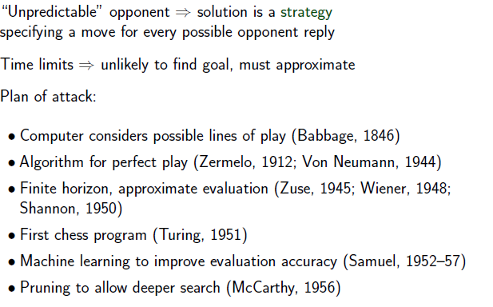
Search in Games

Slide 72
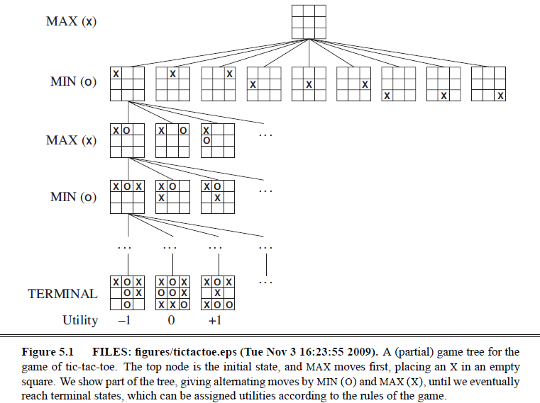
Tic-Tac-Toe

Slide 73
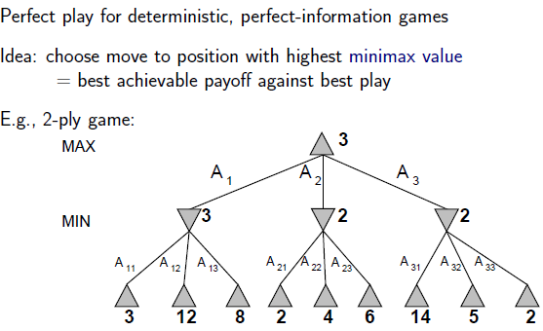
Minimax search

Slide 74
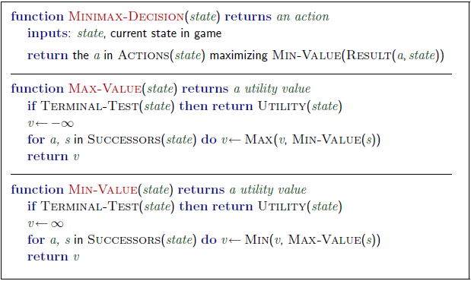
Minimax algorithm

Slide 75
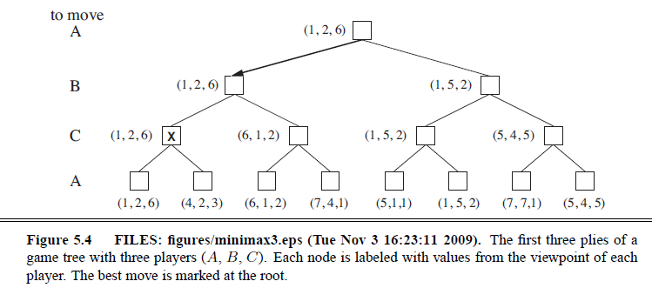
3 player Minimax
Two player minimax reduces to one number because utilities are opposite – knowing one is enough
But there should actually be a vector of two utilities with player choosing to maximize their utility at their turn
So with three players → you have a 3 vector
Alliances?

Slide 76
Minimax properties
Complete?
Only if tree is finite
Note: A finite strategy can exist for an infinite tree!
Optimal?
Yes, against an optimal opponent! Otherwise, hmmmm
Time Complexity?
O($b^{m})$
Space Complexity?
O(bm)
Chess:
b ~= 35, m ~= 100 for reasonable games
Exact solution still completely infeasible

Slide 77
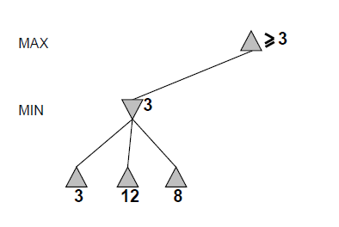
Alpha-beta pruning

Slide 78
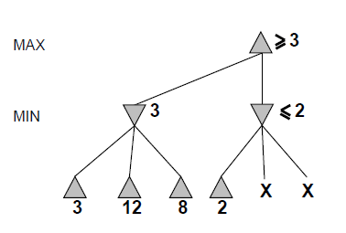
Alpha-beta

Slide 79
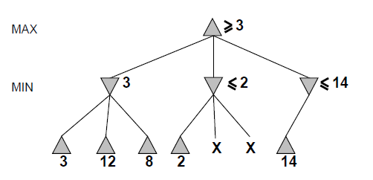
Alpha-beta

Slide 80
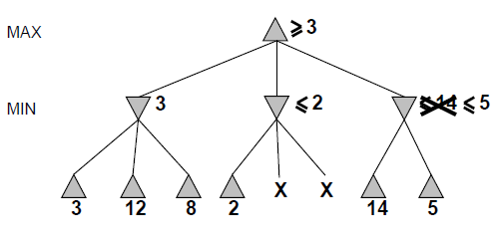
Alpha-beta

Slide 81
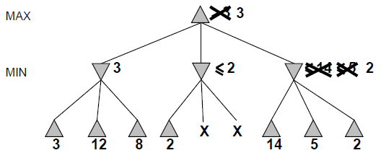
Alpha-beta

Slide 82
Alpha-beta
Alpha is the best value (for Max) found so far at any choice point along the path for Max
Best means highest
If utility v is worse than alpha, max will avoid it
Beta is the best value (for Min) found so far at any choice point along the path for Min
Best means lowest
If utility v is larger than beta, min will avoid it

Slide 83
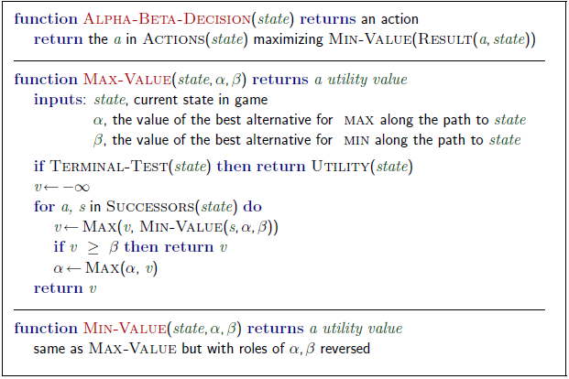
Alpha-beta algorithm

Slide 84
Alpha beta example
Minimax(root)
= max (min (3, 12, 8), min(2, x, y), min (14, 5, 2))
= max(3, min(2, x, y), 2)
= max(3, aValue <= 2, 2)
= 3

Slide 85
Alpha-beta pruning analysis
Alpha-beta pruning can reduce the effective branching factor
Alpha-beta pruning’s effectiveness is heavily dependent on MOVE ORDERING
14, 5, 2 versus 2, 5, 14
If we can order moves well
O($b^{\frac{m}{2} })$
Which is O(($b^{1/2}$)$.^{m}$
Effective branching factor then become square root of b
For chess this is huge → from 35 to 6
Alpha-beta can solve a tree twice as deep as minimax in the same amount of time!
Chess: Try captures first, then threats, then forward moves, then backward moves comes close to b = 12

Slide 86
Imperfect information
You still cannot reach all leaves of the chess search tree!
What can we do?
Go as deep as you can, then
Utility Value = Evaluate(Current Board)
Proposed in 1950 by Claude Shannon

Slide 87
Search
Problem solving by searching for a solution in a space of possible solutions
Uninformed versus Informed search
Atomic representation of state
Solutions are fixed sequences of actions

