Slide 1
Evolutionary Computation
Instructor: Sushil Louis, sushil@cse.unr.edu, http://www.cse.unr.edu/~sushil

Slide 2
Announcements
Papers
  Best case:
    One GA theory/technique paper
    One in your project area
Think about projects
  Optionally, think about group projects
  We will schedule class time for project discussions and grouping

Slide 3
Randomized versus Random versus Deterministic search algorithms
We want fast, reliable, near-optimal solutions from our algorithms
Reliability
Speed
Performance
Deterministic
  Search once
Random
  Average over multiple runs
Randomized hill climber, GA, SA, …
  Average over multiple runs
We need reproducible results so understand the role of the random seed in a random number generator

Slide 4
Representations
Why binary?
  Later
Multiple parameters (x, y, z…)
  Encode x, encode y, encode z, … concatenate encodings to build chromosome
  As an example consider the DeJong Functions
And now for something completely different: Floorplanning
TSP
  Later
JSSP/OSSP/…
  Later

Slide 5
Representations
[-x..y] ?
Min, max, precision and number of bits

Slide 6
GA Theory
Why fitness proportional selection?
  Fitness proportional selection optimizes the tradeoff between exploration and exploitation. Minimizes the expected loss from choosing unwisely among competing schema
Why binary representations?
  Binary representations maximize the ratio of the number of schemas to number of strings
Excuse me, but what is a schema?
Mutation can be thought of as beam hill-climbing. Why have crossover?
  Crossover allows information exchange that can lead to better performance in some spaces

Slide 7
Schemas
What does part of a string that encodes a candidate solution signify?
1
1
1
0
0
0
A point in the search space
1
1
1
An area of the search space
Different kinds of crossover lead to different kinds of areas that need to be described
1
0
1
A different kind of area
1
*
*
0
1
*
A schema denotes a portion of the search space

Slide 8
Schema notation
Schema H = 01*0* denotes the set of strings:
  01000
  01001
  01100
  01101

Slide 9
Schema properties
Order of a schema H →O(H)
  Number of fixed positions
  O(10**0) = 3
Defining length of a schema
  Distance between first and last fixed position
  d(10**0) = 4
  d(*1*00) = 3

Slide 10
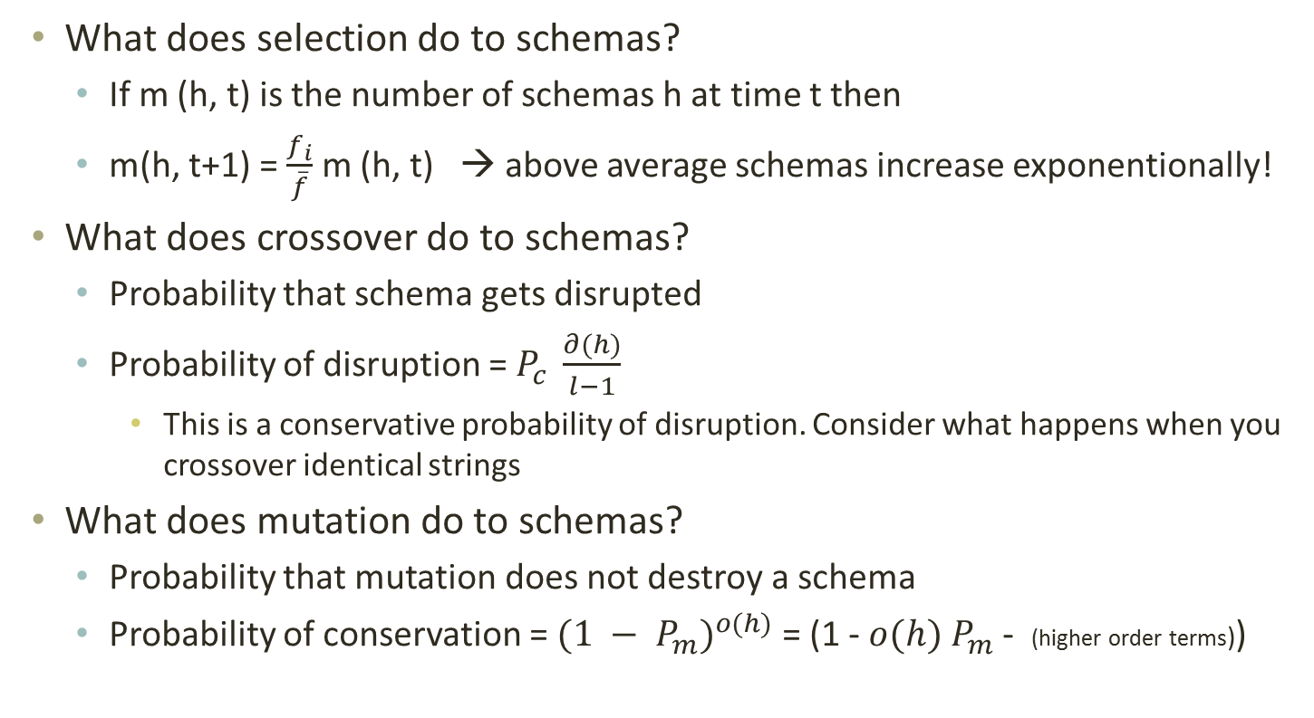
What does GA do to schemas?
What does selection do to schemas?
  If m (h, t) is the number of schemas h at time t then
  m(h, t+1) = $\frac{f_{i}}{\overline{f}}$ m (h, t) → above average schemas increase exponentionally!
What does crossover do to schemas?
  Probability that schema gets disrupted
  Probability of disruption = $P_{c} \frac{∂(h)}{l−1}$
    This is a conservative probability of disruption. Consider what happens when you crossover identical strings
What does mutation do to schemas?
  Probability that mutation does not destroy a schema
  Probability of conservation = ${(1 − P_{m})}^{o(h)}$ = (1 - $o(h)$ $P_{m}$ - (higher order terms))

Slide 11
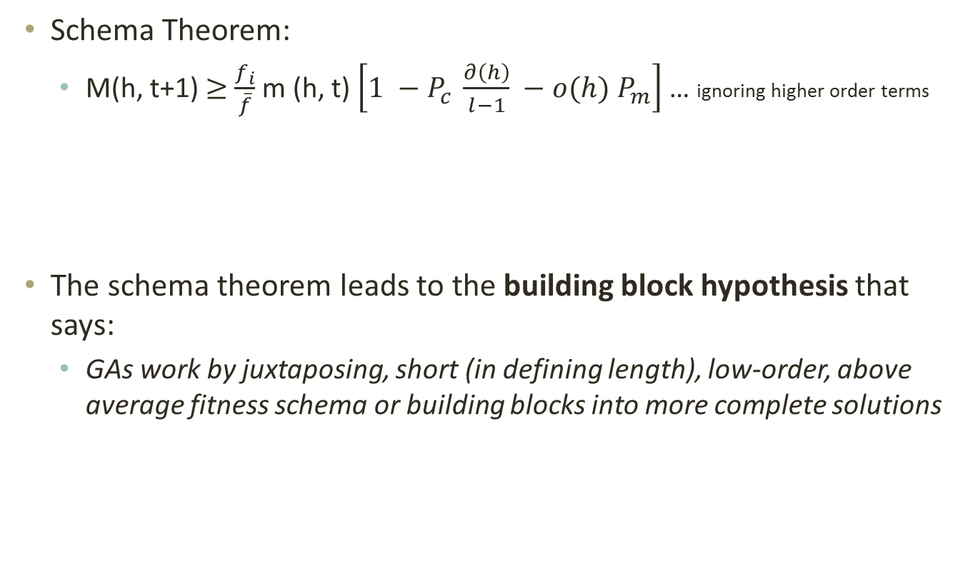
The Schema theorem
Schema Theorem:
  M(h, t+1) $≥$ $\frac{f_{i}}{\overline{f}}$ m (h, t) $\left[1 −P_{c} \frac{∂\left(h\right)}{l−1} −o(h) P_{m}\right]$ … ignoring higher order terms
The schema theorem leads to the building block hypothesis that says:
  GAs work by juxtaposing, short (in defining length), low-order, above average fitness schema or building blocks into more complete solutions

Slide 12
Schema processing
String decoded f(x^2) fi/Sum(fi) Expected Actual
01101 | 13 | 169 | 0.14 | 0.58 | 1
11000 | 24 | 576 | 0.49 | 1.97 | 2
01000 | 8 | 64 | 0.06 | 0.22 | 0
10011 | 19 | 361 | 0.31 | 1.23 | 1
Sum |  | 1170 | 1.0 | 4.00 | 4.00
Avg |  | 293 | .25 | 1.00 | 1.00
Max |  | 576 | .49 | 1.97 | 2.00
 |  | Fitness
1**** | 2,4 | 469 |  | 3.2 | 3
*10** | 2,3 | 320 |  | 2.18 | 2
1***0 | 2 | 576 |  | 1.97 | 2

Slide 13
Schema processing…
String mate offspring decoded f(x^2)
0110|1 | 2 | 01100 | 12 | 144
1100|0 | 1 | 11001 | 25 | 625
11|000 | 4 | 11011 | 27 | 729
10|011 | 3 | 10000 | 16 | 256
Sum |  |  |  | 1754
Avg |  |  |  | 439
Max |  |  |  | 729
 | Exp count | Actual | Represented by | Exp after all ops | Actual after all ops
1**** | 3.2 | 3 | 2,3,4 | 3.2 | 3 | 2,3,4
*10** | 2.18 | 2 | 2,3 | 1.64 | 2 | 2,3
1***0 | 1.97 | 2 | 2,3 | 0.0 | 1 | 4

Slide 14
Schemas, schemata
How many strings in 1**0?
How many schemas in 1000?
Consider base 3
How many string in 12*0?
How many schemas in 1230?
Base 4 (All life on earth?)

Slide 15
Why base 2?
Which cardinality alphabet maximizes number of schema?
base 2 = 3^l/2^l, base 3 = 4^l/3^l, …

Slide 16
Questions
Parameter values:
  Populations size? As large as possible (for x^2 start with 50)
  Number of generations? Depends on selection strategy and problem (for x^2 pop of 50 try 100)
  Debug hint: Try popsize of 2 run for 1 generation
Crossover probability (pcross):
  Depends on selection strategy and problem (try 0.667)
  What do you expect the GA “does” when pcross and pmut are 0?
Mutation probability (pmut):
  Depends on selection strategy and problem (try 0.001)
  What do you expect to see when pmut is high (0.2) or low (0.0)?
Problem: What do you expect on fitness function:
  F(x) = 100, F(x) = number of ones. F(x) = x^2, F(x) = 2^x, F(x) = x!

Slide 17
Representations
[-x..y] ?
Min, max, precision and number of bits

Slide 18
For each parameter in chrom
Min + decode(chrom[start], size) * precision
Precision = (max – min) / 2^n
n = Ceiling(logbase2(max – min))

Slide 19
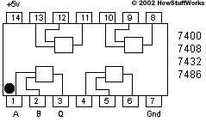
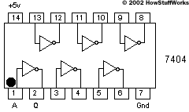
Designing a parity checker
Parity: if even number of 1s in input correct output is 0, else output is 1
Important for computer memory and data communication chips
Search for circuit that performs parity checking
What is the genotype? – selected, crossed over and mutated
A circuit is the phenotype – evaluated for fitness.
How do you construct a phenotype from a genotype to evaluate?

Slide 20
What is a genotype?
A genotype is a bit string that codes for a phenotype
1
1
0
1
0
0
1
0
0
1
1
1
Randomly chosen crossover point
1
1
1
1
1
1
1
1
0
0
0
0
Parents
Crossover
Offspring
0
0
0
0
0
0
0
0
1
1
1
1
Mutation
1
1
1
1
1
1
Randomly chosen mutation point
1
1
1
1
0
1

Slide 21
Genotype to Phenotype mapping
A circuit is made of logic gates. Receives input from the 1st column and we check output at last column.
1
6
11
16
21
26
31
Each group of five bits codes for one of 16 possible gates and the location of second input
146

Slide 22
Genotype to Phenotype mapping
150 length binary string
1
1
0
1
0
0
1
0
0
1
1
1
1
0
1
1
1
0
1
1 row of 150
becomes
6 rows of 25
0
1
0
1
0
0
1
1
0
0
0
0
0
0
1
0
1
1
0
0
1
1
1
0
1
1
0
0
0
1
0
0
0
0
1

Slide 23
Evaluating the phenotype
Feed the gate an input combination
Check whether the output produced by a decoded member of the population is correct
Give one point for each correct output
That is: Simulate the circuit
  The black box can be a simulation

Slide 24
Circuits
Parity Checker
Adder

Slide 25
Predicting subsurface structure
Find subsurface structure that agrees with experimental observations
Mining, oil exploration, swimming pools

Slide 26
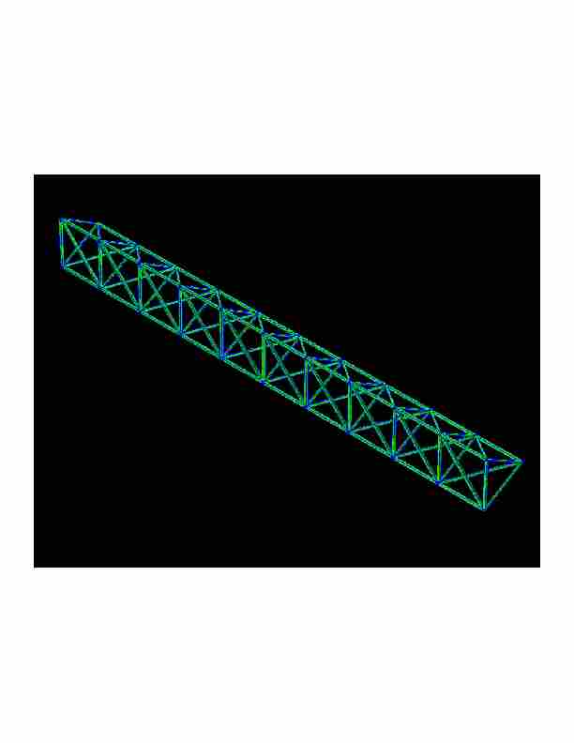
Designing a truss
Find a truss configuration that minimizes vibration, minimizes weight, and maximizes stiffness

Slide 27
Traveling Salesperson Problem
Find a shortest length tour of N cities
N! possible tours
10! = 3628800
70! = 11978571669969891796072783721689098736458938142546425857555362864628009582789845319680000000000000000
Chip layout, truck routing, logistics

Slide 28
GA Theory
Why fitness proportional selection?
  Fitness proportional selection optimizes the tradeoff between exploration and exploitation. Minimizes the expected loss from choosing unwisely among competing schema
Why binary representations?
  Binary representations maximize the ratio of the number of schemas to number of strings
Mutation can be thought of as beam hill-climbing. Why have crossover?
  Crossover allows information exchange that can lead to better performance in some spaces

Slide 29
The Schema theorem
Schema Theorem:
  M(h, t+1) $≥$ $\frac{f_{i}}{\overline{f}}$ m (h, t) $\left[1 −P_{c} \frac{∂\left(h\right)}{l−1} −o(h) P_{m}\right]$ … ignoring higher order terms
The schema theorem leads to the building block hypothesis that says:
  GAs work by juxtaposing, short (in defining length), low-order, above average fitness schema or building blocks into more complete solutions

