Slide 1
Evolutionary Computation
Instructor: Sushil Louis, sushil@cse.unr.edu, http://www.cse.unr.edu/~sushil

Slide 2
Announcements
Papers
  Best case:
    One GA theory/technique paper
    One in your project area
Think about projects
  Optionally, think about group projects
  We will schedule class time for project discussions and grouping

Slide 3
Representations
Why binary?
  Later
Multiple parameters (x, y, z…)
  Encode x, encode y, encode z, … concatenate encodings to build chromosome
  As an example consider the DeJong Functions
And now for something completely different: Floorplanning
TSP
  Later
JSSP/OSSP/…
  Later

Slide 4
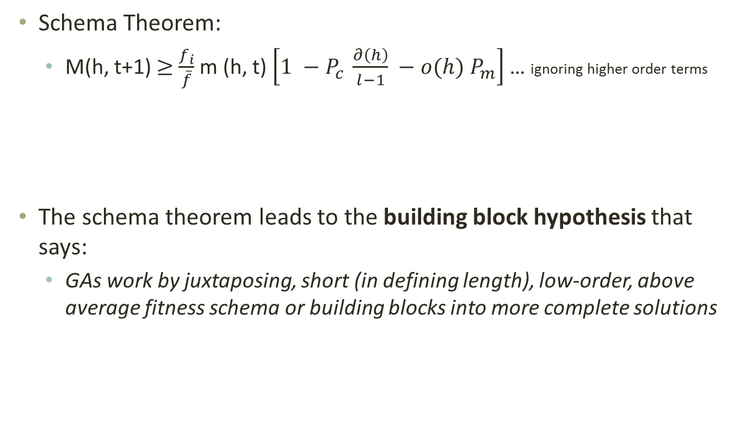
The Schema theorem
Schema Theorem:
  M(h, t+1) $≥$ $\frac{f_{i}}{\overline{f}}$ m (h, t) $\left[1 −P_{c} \frac{∂\left(h\right)}{l−1} −o(h) P_{m}\right]$ … ignoring higher order terms
The schema theorem leads to the building block hypothesis that says:
  GAs work by juxtaposing, short (in defining length), low-order, above average fitness schema or building blocks into more complete solutions

Slide 5
Schema processing
String decoded f(x^2) fi/Sum(fi) Expected Actual
01101 | 13 | 169 | 0.14 | 0.58 | 1
11000 | 24 | 576 | 0.49 | 1.97 | 2
01000 | 8 | 64 | 0.06 | 0.22 | 0
10011 | 19 | 361 | 0.31 | 1.23 | 1
Sum |  | 1170 | 1.0 | 4.00 | 4.00
Avg |  | 293 | .25 | 1.00 | 1.00
Max |  | 576 | .49 | 1.97 | 2.00
 |  | Fitness
1**** | 2,4 | 469 |  | 3.2 | 3
*10** | 2,3 | 320 |  | 2.18 | 2
1***0 | 2 | 576 |  | 1.97 | 2

Slide 6
Schema processing…
String mate offspring decoded f(x^2)
0110|1 | 2 | 01100 | 12 | 144
1100|0 | 1 | 11001 | 25 | 625
11|000 | 4 | 11011 | 27 | 729
10|011 | 3 | 10000 | 16 | 256
Sum |  |  |  | 1754
Avg |  |  |  | 439
Max |  |  |  | 729
 | Exp count | Actual | Represented by | Exp after all ops | Actual after all ops
1**** | 3.2 | 3 | 2,3,4 | 3.2 | 3 | 2,3,4
*10** | 2.18 | 2 | 2,3 | 1.64 | 2 | 2,3
1***0 | 1.97 | 2 | 2,3 | 0.0 | 1 | 4

Slide 7
Schemas, schemata
How many strings in 1**0?
How many schemas in 1000?
Consider base 3
How many string in 12*0?
How many schemas in 1230?
Base 4 (All life on earth?)

Slide 8
Why base 2?
Which cardinality alphabet maximizes number of schema?
base 2 = 3^l/2^l, base 3 = 4^l/3^l, …

Slide 9
Questions
Parameter values:
  Populations size? As large as possible (for x^2 start with 50)
  Number of generations? Depends on selection strategy and problem (for x^2 pop of 50 try 100)
  Debug hint: Try popsize of 2 run for 1 generation
Crossover probability (pcross):
  Depends on selection strategy and problem (try 0.667)
  What do you expect the GA “does” when pcross and pmut are 0?
Mutation probability (pmut):
  Depends on selection strategy and problem (try 0.001)
  What do you expect to see when pmut is high (0.2) or low (0.0)?
Problem: What do you expect on fitness function:
  F(x) = 100, F(x) = number of ones. F(x) = x^2, F(x) = 2^x, F(x) = x!

Slide 10
Traveling Salesperson Problem
Find a shortest length tour of N cities
N! possible tours
10! = 3628800
70! = 11978571669969891796072783721689098736458938142546425857555362864628009582789845319680000000000000000
Chip layout, truck routing, logistics

Slide 11
Sequential encodings
Crossover produces illegal offspring
Mutation produces illegal offspring
Modify crossover and mutation
Mutation ➔ swap mutation
Crossover ➔ PMX
  Exchanges important ordering similarities
  A = 9 8 4 | 5 6 7 | 1 3 2 10
  B = 8 7 1 | 2 3 10 | 9 5 4 6
  A’ = 9 8 4 | 2 3 10 | 1 6 5 7
  B’ = 8 10 1 | 5 6 7 | 9 2 4 3

Slide 12
GA is not a hill climber
Canonical GA was not designed for function optimization
  Fitness proportional selection
  One point crossover, Pc = 0.667
  Point flip mutation, Pm = 0.001
GA for function optimization
  Elitist selection – never lose the best
    Tournament selection
    (µ + λ) selection
      (100 + 100) selection: 100 parents produce 100 offspring
      Deterministically select best 100 from combined 200 (parents + offspring)
  Multi-point crossover, Pc = 0.9 !
  Higher Pm = 0.01 !

Slide 13
CHC - Eshelman
    Cross generational (µ + µ) selection, half uniform crossover, no mutation
    When converged
      Get best individual
      Generate new population of size µ from highly mutated versions of this best individual (cataclysmic mutation on convergence)
      Run again
    Steady state selection – Whitley
      Select two parents produce two offspring
      Two offspring replace worst two individuals in population
      Repeat

Slide 14
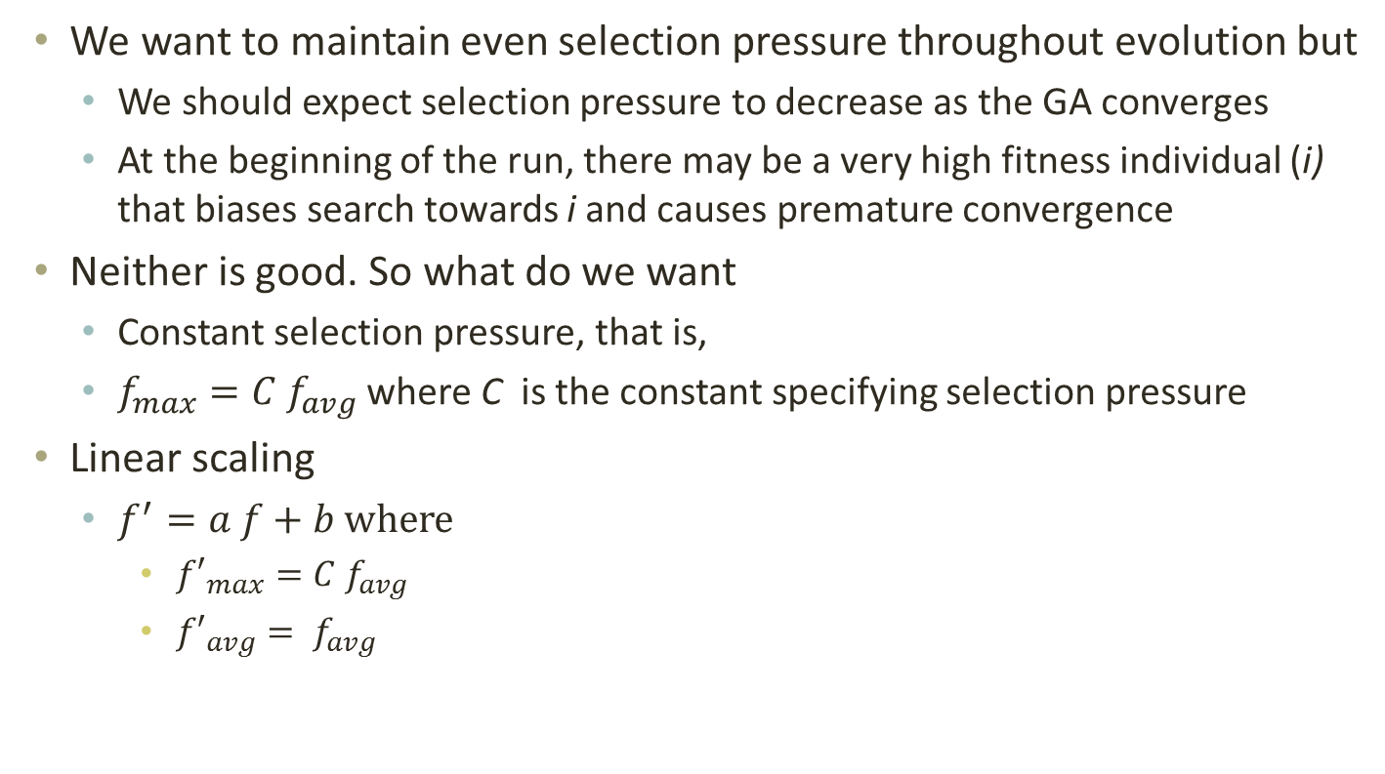
Scaling
We want to maintain even selection pressure throughout evolution but
  We should expect selection pressure to decrease as the GA converges
  At the beginning of the run, there may be a very high fitness individual (i) that biases search towards i and causes premature convergence
Neither is good. So what do we want
  Constant selection pressure, that is,
  $f_{max}=C f_{avg}$ where C is the constant specifying selection pressure
Linear scaling
  $f^{′}=a f+b$ where
    ${f′}_{max}=C f_{avg}$
    ${f′}_{avg}= f_{avg}$

Slide 15
Presentations
20 minutes
What is the problem?
Summary of results
Details: What is the problem, why is it interesting? Who else has worked on this problem and similar problems?
How did they solve the problem (Methodology)?
What were the results (graphs, tables)?
What is their conclusion and why is it substantiated by results

Slide 16
Project Abstract
Due November 20, 2019
One page max (unless you have images)
  What problem are you attacking?
  Why is this problem interesting?
  Why is this problem suitable for an evolutionary computing approach?
  What is your approach? Possible representations and GA operators.
  What results do you expect? Compared to what?

Slide 17
Project Proposal Presentation
November 20, November 25
  15 minutes max
  5 slides max
Answer these questions
  What problem are you attacking?
  Why is this problem interesting?
  Why is this problem suitable for an evolutionary computing approach?
  What is your approach? Representations and GA ops
  What results do you expect? Compared to what?

Slide 18
Presentations
20 minutes including inline questions
Presenter
  Read paper, follow references, prepare presentation, send draft to me, present
  Each student must be on at least one presenter team
Seconds
  Read paper, follow references, prepare questions to ask presenter to clarify presentation, come up with questions during presentation
  Each student must be on at least TWO second teams
Everyone
  Read the paper
  Ask questions
    If you don’t have questions? This is an indication that
      You have not read the paper
      You do not want to understand the paper ☹

