Slide 1
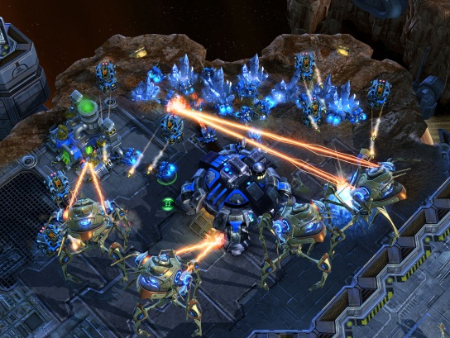
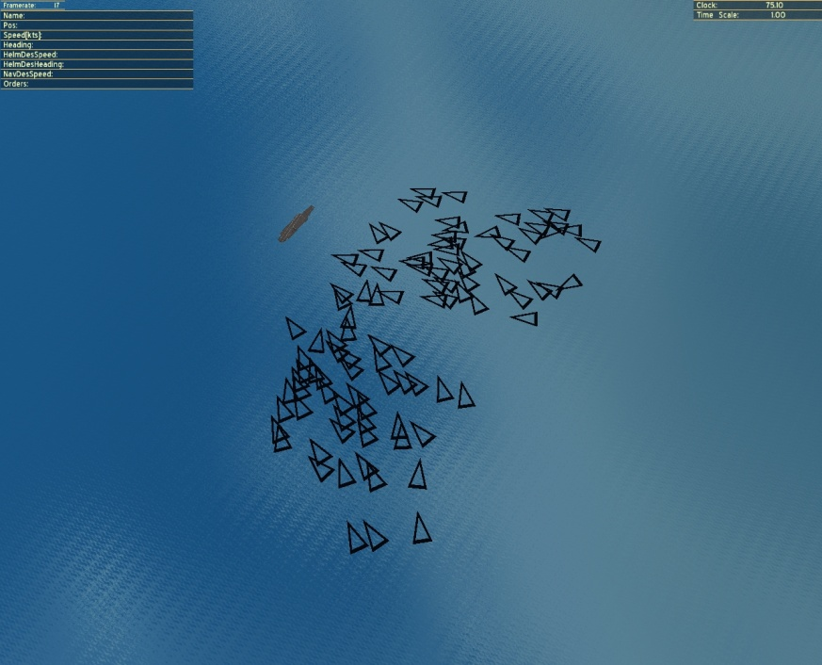
WaterCRAFT
CS790R Modeling and Simulation
Fall 2013
Will develop a clone of Starcraft2 based on OpenECSLent.
http://www.cse.unr.edu/~sushil/openEcslent
Register now
Email: sushil@cse.unr.edu
for more information

